Slide 1
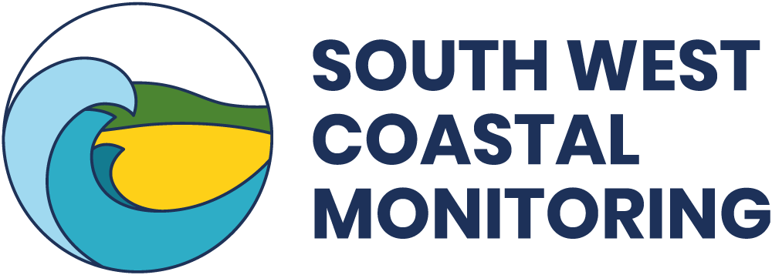
The Dynamic Coast…..
…Can Torcross be defended
from the sea?
South West Coastal Monitoring in collaboration with Geography Southwest
Ppt. 3 of 4

Slide 2
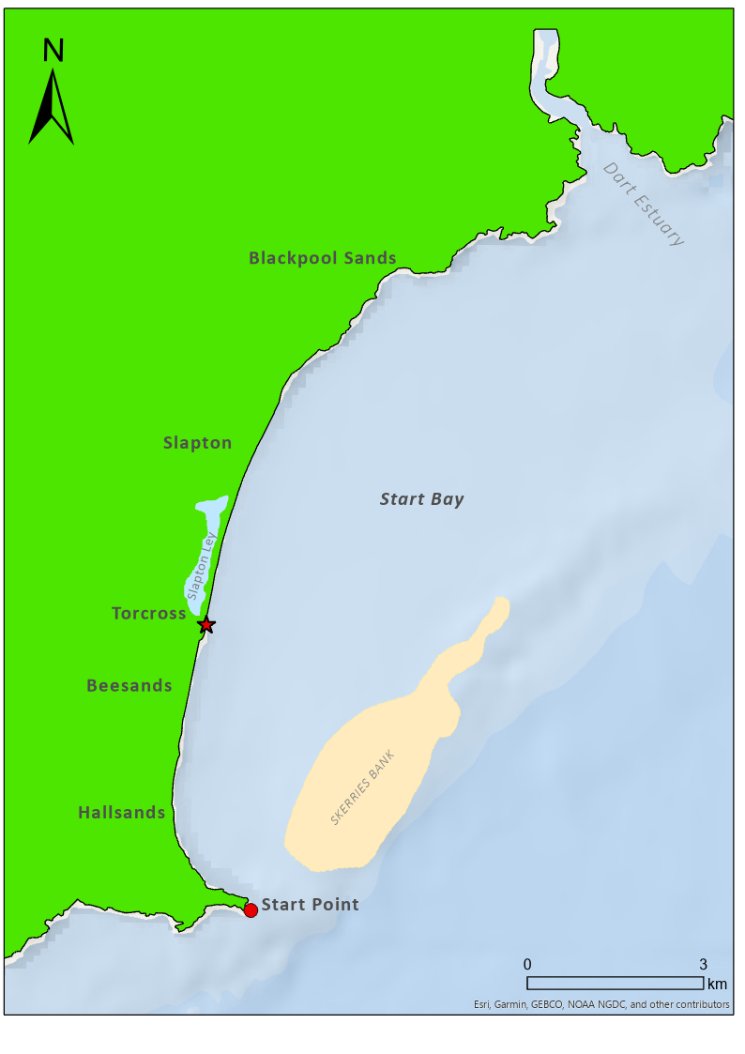
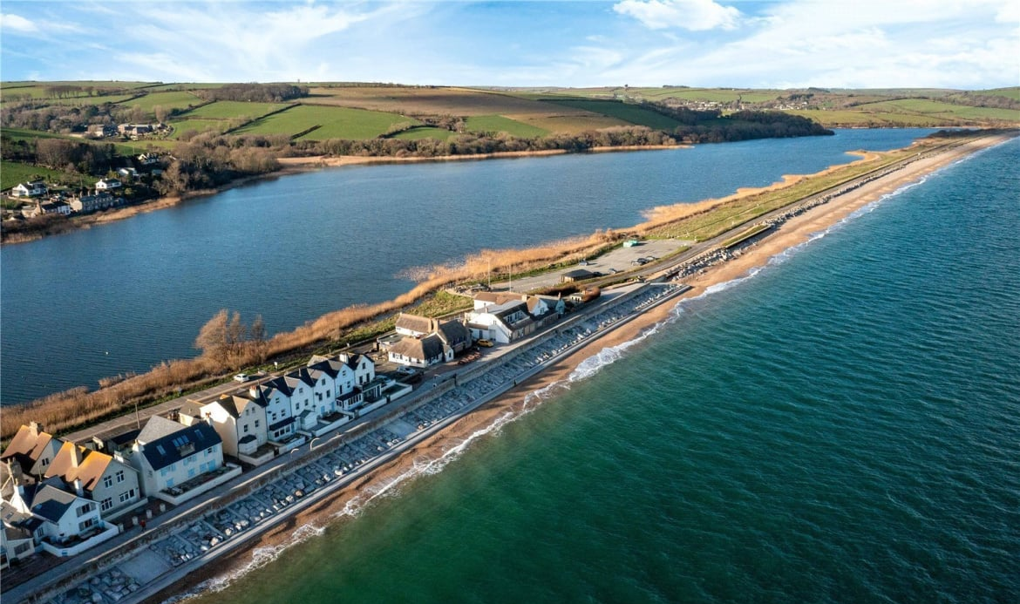
Where is Torcross?
Torcross is located at the southern end of Slapton Ley, the freshwater lagoon trapped behind the barrier beach in Start Bay.
The photo shows that the village is wrapped around the southern end of the lagoon.
Parts of the village have been built along the seafront at the top of the beach.

Slide 3
Is Torcross at risk from the sea?
This photo shows the seafront houses at Torcross. Today, the village is protected by a high seawall and a wide concrete revetment. Notice the huge boulders encased within the concrete.
This photo was taken at high tide. Notice the absence of a beach. The waves are breaking against the base of the sea wall.
Whilst Torcross is now well protected from the sea, this has not always been the case.

Slide 4
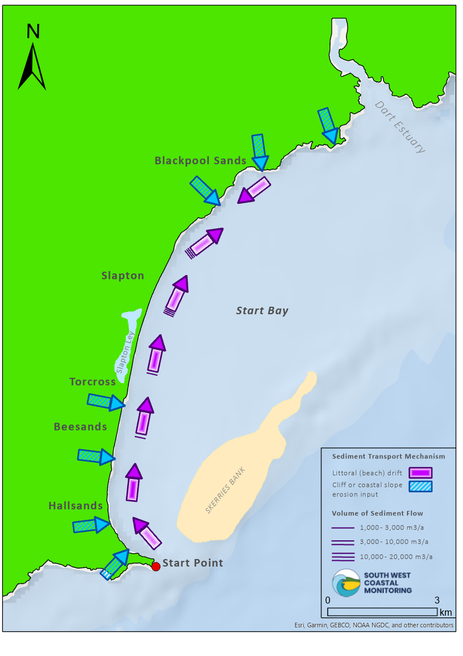
Storms and the sediment cell
This map shows the Start Bay sediment cell (see PowerPoint 3).
It shows the sources of sediment from cliff erosion (blue arrows) and the longshore drift of sediment (purple arrows).
Locate Torcross. Notice that sediment is moving northwards (by longshore drift) towards Slapton Sands.
Over time, at Torcross, more sediment has been lost to the north, than gained from the south. This has gradually reduced the width of the beach.

Slide 5
Torcross: exposed and unprotected (1907)
This photo shows Torcross in 1907. Notice that there is only a low wall and promenade between the beach and the houses.
The main defence in 1907 was the very wide beach. This forced waves to break early, absorbing their energy.
However, beaches are dynamic. They can be quickly eroded by storms leaving settlements dangerously exposed.
In just ten years from when this photo was taken, Hallsands was destroyed, left unprotected as its beach was eroded.
Photo: P00376

Slide 6
Torcross: storm damage, 1951
In 1951, high seas tore apart the foundations of the promenade causing some of it to collapse.
Notice how the beach is much lower than it was in 1907. Sediment transfer northwards and erosion during storms had removed sediment. The beach was now far less effective in protecting the coast and the village was much more exposed.
In 1979, another powerful storm struck Torcross damaging several houses.
Photo: P00383

Slide 7
Defending Torcross (1979)
Following the storm in 1979, a seawall was constructed to protect Torcross.
At the eastern end of the village, huge boulders were arranged to form a protective wall (top photo). This type of coastal defence is called rock armour. The large boulders force waves to break, losing their energy before reaching the houses.
In the years that followed, the seawall was extended and strengthened using concrete sheet piling (bottom photo).
Photo: P00593a

Slide 8
Torcross in the 1980s
Despite reinforcements of the seawall, Torcross continued to be pounded by heavy seas throughout the 1980s.
One of the main reasons for this was the continuing erosion of the once extensive beach at Torcross.
Longshore drift driven by predominantly southerly winds (and waves) had transported much of the shingle northwards. Torcross was no longer protected by its beach.
Photo: P1105

Slide 9
Winter storms, 2014
In 2014, a series of storms dramatically lowered the beach at Torcross.
The defences at Torcross were exposed and huge waves smashed windows and caused significant damage to seafront houses.
Following the storms, South Hams District Council spent £250,000 on additional seawall repairs.

Slide 10
Storms and high tides, 2016
Just two years later in February 2016 storms, combined with very high tides, caused the partial collapse of the seawall at Torcross.
Erosion resulted in the closure of the main road between Torcross and Slapton.
Despite the repairs in 2014, holes soon appeared behind the seawall just before the storms hit in 2016.
It was clear that more substantial repairs would be needed in the future to protect Torcross.

Slide 11
Torcross: new coastal defences, 2017
In 2017 the seawall was further strengthened, at a cost of £2.4m.
A concrete capping beam was constructed to strengthen the base of the existing seawall.
Steel prefabricated cages (shown in the photo alongside) were set at the base of the seawall and concrete was poured in to create a continuous protective beam.
This was then covered with shingle.

Slide 12
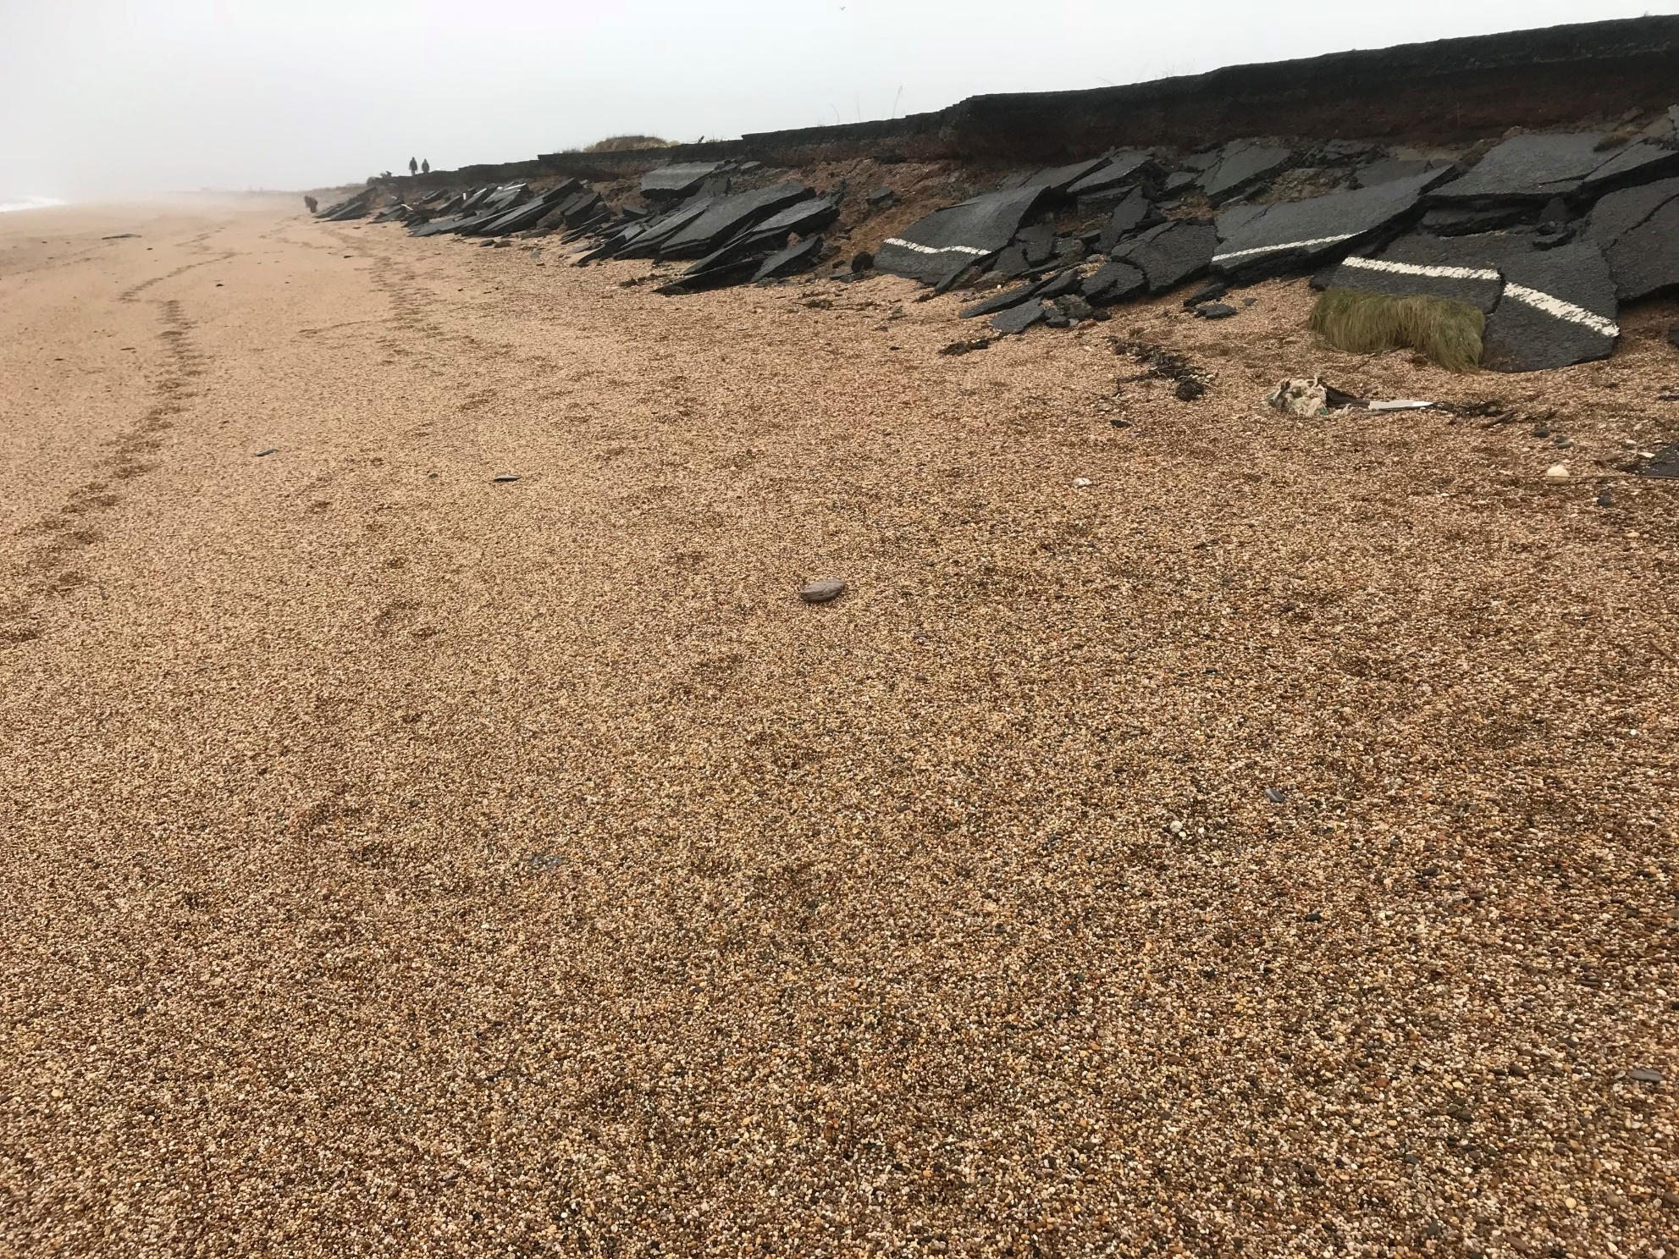
The ‘Beast from the East’, 2018
The coastal road was destroyed
In the following year, much of the UK was struck by a severe storm that became known as the ‘Beast from the East’.
Large waves, driven onshore by storm-force easterly winds combined with high-spring tides, caused significant coastal erosion and damage to sea defences.
This photo shows storm damage to the main A379 road between Torcross and Slapton Sands (March, 2018). The road was closed for several weeks.
It was a storm similar to this, that destroyed Hallsands in 1917.

Slide 13
Winter storm, January 16th 2020
In 2020, a severe winter storm tested the newly strengthened sea defences at Torcross.
Click the link below to see the impact of the storm.
https://www.youtube.com/watch?v=nF8F7k0CapQ
Notice that the seawall prevents the waves from directly reaching the houses, despite causing them to send spray over the top.
Notice too how the holes in the seawall allow water to drain away when the waves retreat.

Slide 14
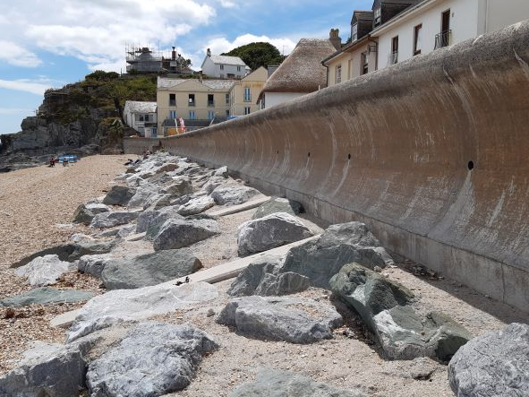
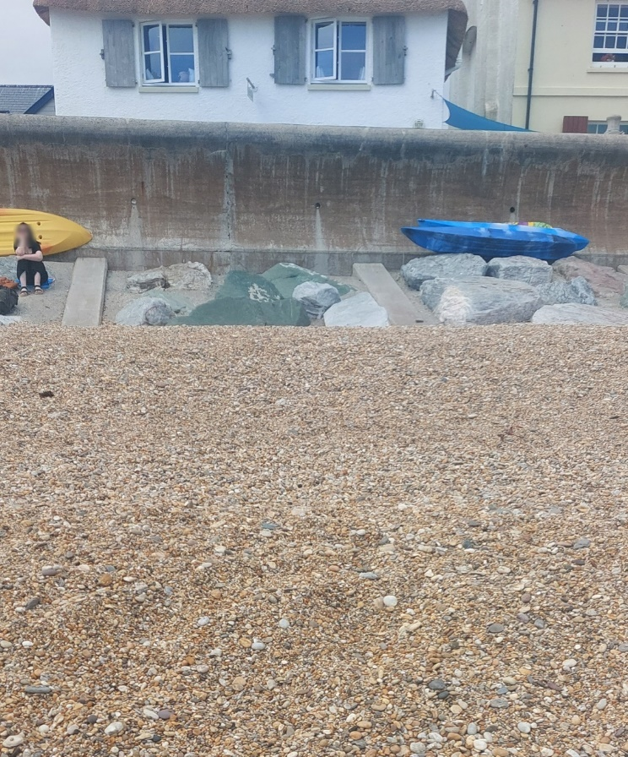
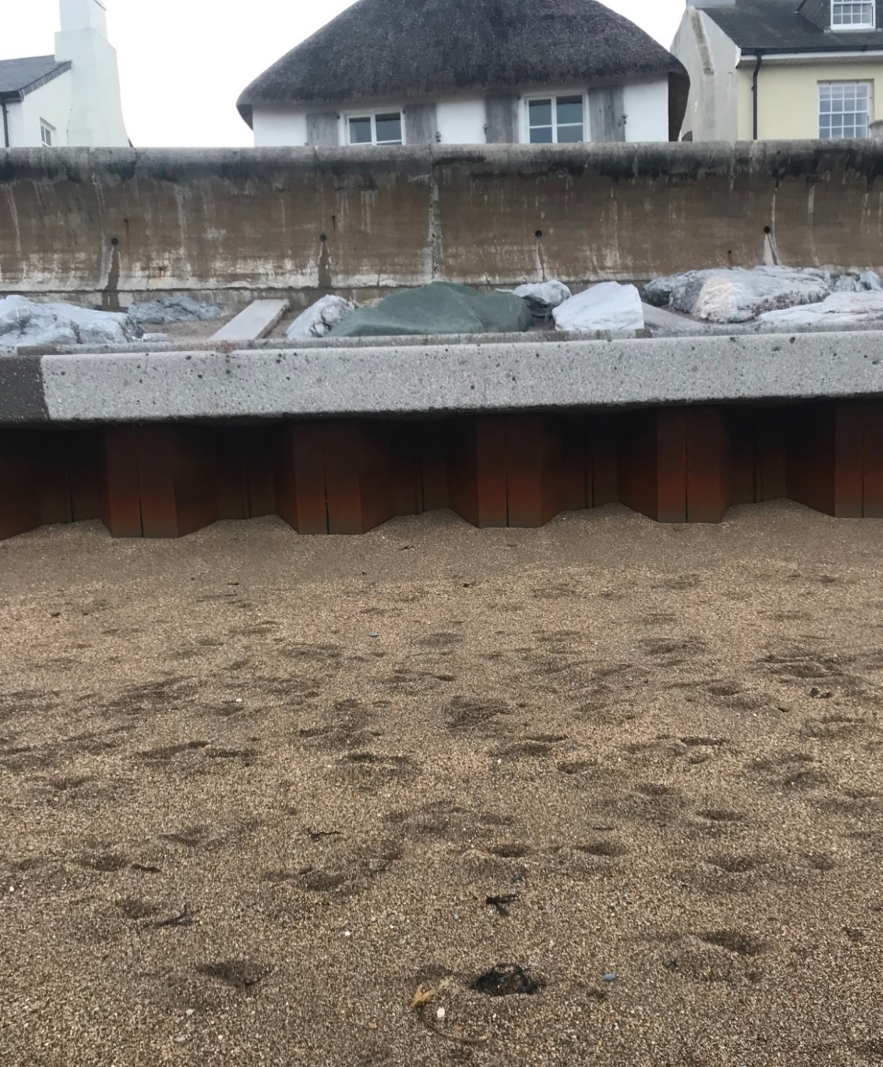
Torcross, 2022
These photos show the sea defences at Torcross in the summer and autumn of 2022.
The concrete beam, which was constructed in 2017, is buried beneath the beach in July. By November, the steel caging is beginning to show, as a result of beach levels dropping due to the seasonal cycle of erosion.
Notice that the seawall itself is curved, causing waves to be reflected back to sea.
The drainage holes in the seawall allow water to flow back out. The broad shingle beach helps to protect the seawall.
July 2022
November 2022

Slide 15
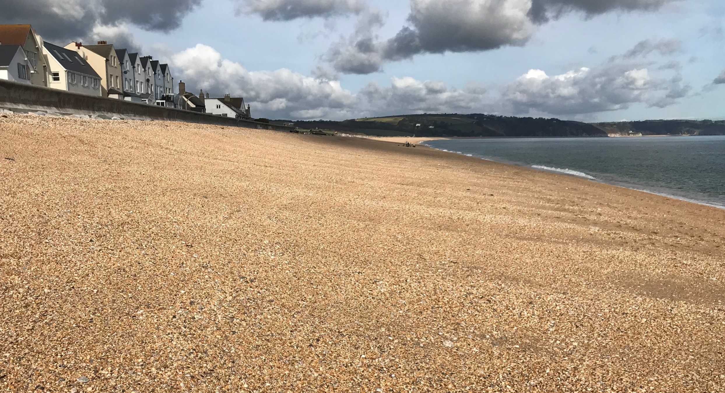
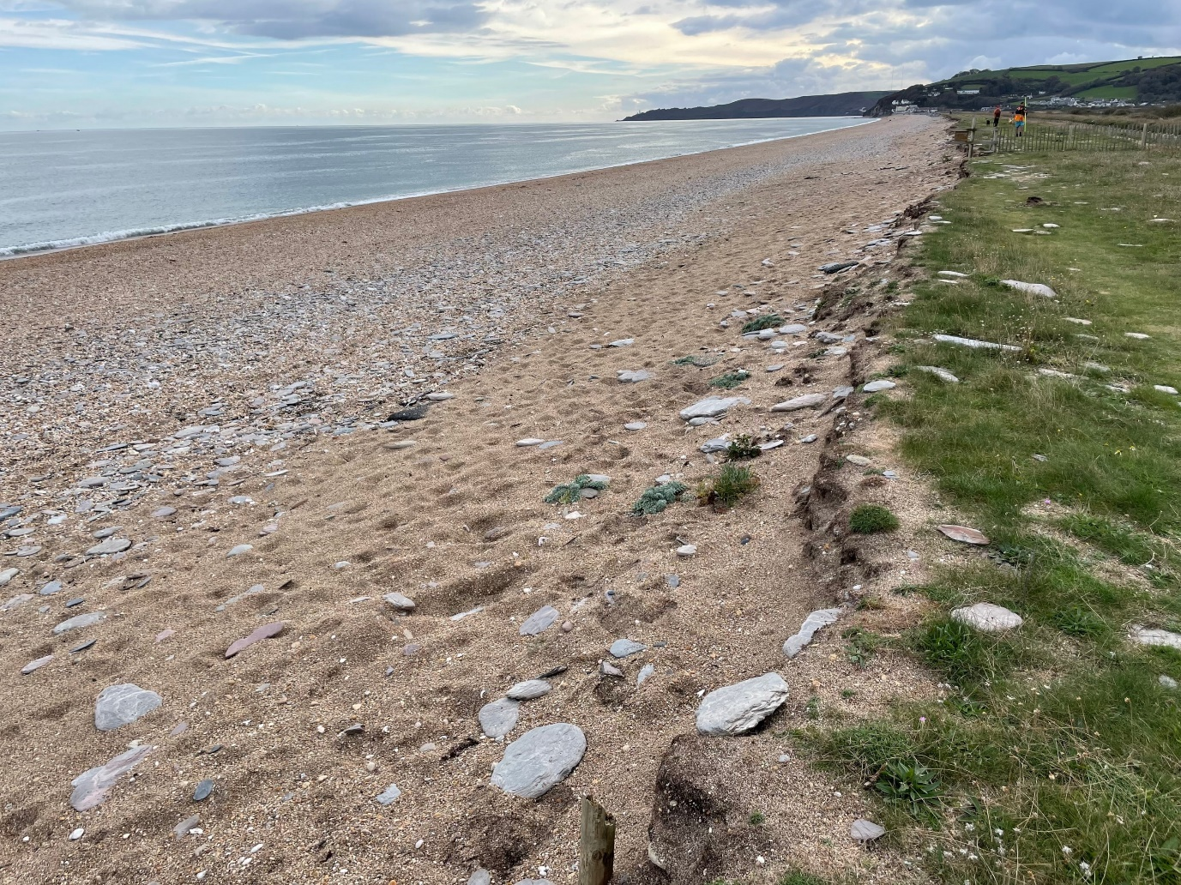
Will Torcross be safe in the future?
Climate change is causing sea levels to rise. Storms may also become more frequent in the future.
The government and Environment Agency (EA) will provide the funds to preserve the current shoreline position at Torcross – this policy is called ‘hold the line’.
Existing sea defences will be maintained and improved to protect the village.
Elsewhere the shoreline position will be allowed to adjust – this is called ‘managed realignment’. The main road (A379) has already been moved back as far as it can.
In the future, the road may be reduced to a single lane or even forced to close.

Slide 16
References
Images:
https://www.scopac.org.uk/scopac_sedimentdb/start/photos/photo5.htm
https://www.bbc.co.uk/news/uk-england-devon-26377103
https://www.ice.org.uk/what-is-civil-engineering/what-do-civil-engineers-do/torcross-sea-defence/#
www.marchandpetit.co.uk
Photos: P00383, P00593a, and P1105 are courtesy of Kingsbridge Cookworthy Museum.
Some photos are courtesy of South West Coastal Monitoring and Geography Southwest.

Slide 17
www.southwest.coastalmonitoring.org
coastal.observatory@plymouth.ac.uk
01752 586155
www.geographysouthwest.co.uk
rosstrout@aol.com
@OfficialPCO
@geographysw_
PlymouthCoastalObservatory
Geographysouthwest
Plymouth.Coastal.Observatory

