Slide 1
The Dynamic Coast…..
…The ‘lost village’ of Start Bay
South West Coastal Monitoring in collaboration with Geography Southwest
Ppt. 2 of 4

Slide 2
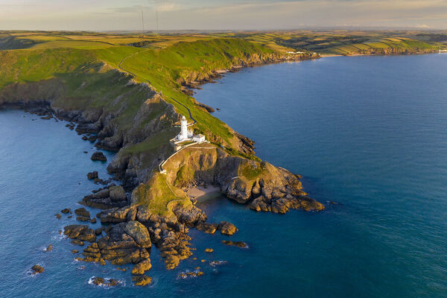
Where is Hallsands?
Hallsands is located at the southern end of Start Bay on the south coast of Devon, UK.

Slide 3
Hallsands today
This photo is looking northwards across Start Bay towards Slapton Sands
Today the village of Hallsands is a cluster of houses located on the clifftop overlooking the sea.
But, in the past, the original fishing village was located on a rocky ledge at the foot of the cliff.
Today all that remains of the old village is a collection of partly destroyed houses and a broken access road.

Slide 4
The ‘lost’ village of Hallsands
The photo shows all that remains of the original fishing village of Hallsands, perched on a rocky ledge at the foot of the cliffs.
In the foreground towards the bottom of the photo you can see the remains of an access road.
The house in the photo is the only one to have survived largely intact after the disaster that swept away most the dwellings in January 1917.

Slide 5
Historical Hallsands
The image alongside shows a busy scene with fishermen attending their nets in 1865. Notice the smoking chimneys, probably burning coal for cooking and heating the homes.
The village of Hallsands was a thriving fishing village specialising in catching shellfish. You can see the special crab pots in the bottom right of the image.
The fishermen’s houses were constructed on a rocky ledge perched above the broad shingle beach.
(Image by kind permission of Paul Way)

Slide 6
Why was the site chosen for the village?
The village houses were constructed on a rocky surface, a landform called a wave-cut platform.
It was formed by wave erosion thousands of years ago, at the end of the last ice age, when sea levels were much higher.
As the ice melted sea levels rose, bulldozing shingle from the floor of the English Channel towards the coast. This formed the extensive beach shown on the previous slide.
Protected by the wide beach, the rocky ledge was seen as an ideal safe site for the small fishing village.

Slide 7
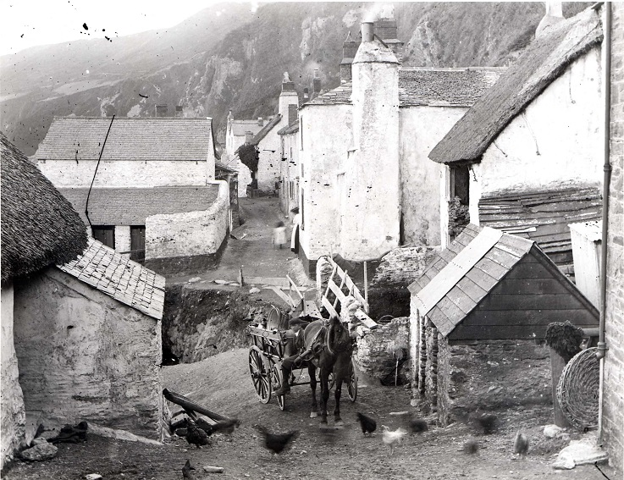
Storm damage, 1904
ID no. 515
ID no. 178
In 1904, severe storms caused widespread damage in Hallsands. Between 1904 and 1917, erosion carved a huge chasm in the rocky platform. Notice the makeshift bridge over the chasm in the right-hand photo.
The damage caused by the 1904 storms suggested that the village was in a perilous position.

Slide 8
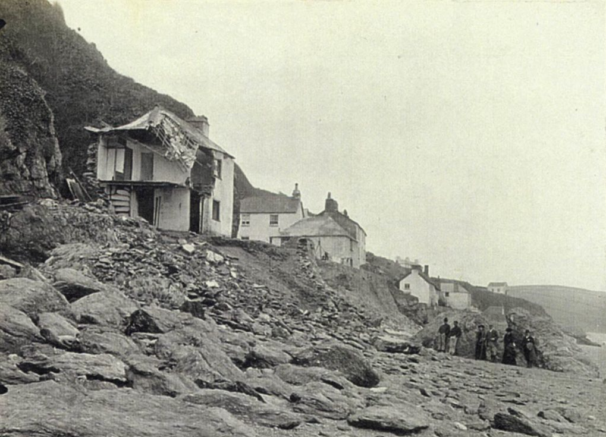
Disaster strikes
ID no. P0247c
On 26 January 1917, a powerful winter storm from the east destroyed much of the village.
Fortunately, no one was killed – all 79 residents scrambled to safety.
However, their homes were destroyed or badly damaged and their livelihoods lost.
“All of a sudden the walls came toppling down, the floor caved in. It felt like being right in the sea, the roaring waves bouncing over us, the rafters all breaking in. We could see the white waves foaming underneath the floors. The coal house all slipping away, no fires, the sea came down the chimney.”
Edith Patey (17), villager. 26 January 1917
ID no. P05055

Slide 9
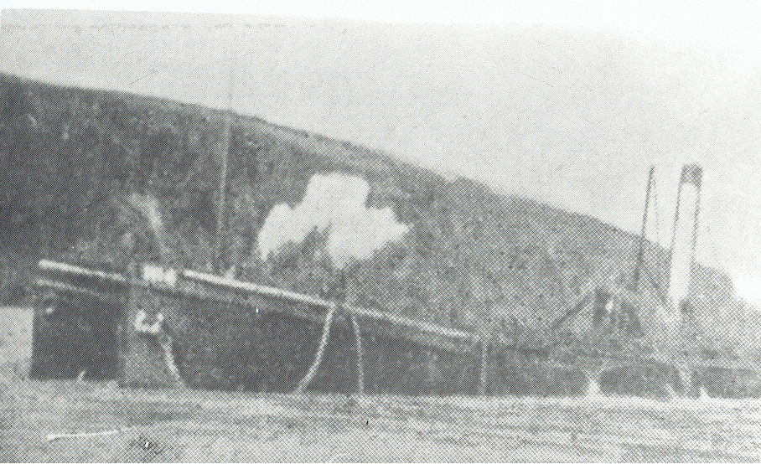
What caused the disaster at Hallsands?
Increased storminess and a dominance of southerly winds eroded and transported sediment from south to north.
Start Point, to the south, prevented fresh sediment from entering Start Bay, so more shingle was lost at Hallsands than gained.
Dredging of shingle in Start Bay, to enlarge Plymouth docks in 1897, before the First World War, depleted the beaches. Engineers failed to realise that sediment would not wash into the bay to replenish that which was removed.
Over a period of several decades at the turn of the century, the beach at Hallsands was eroded. It became lower and narrower, and no longer protected the village from the sea.
Several factors contributed to the erosion of the beach at Hallsands.
The dredging boat in Start Bay.

Slide 10
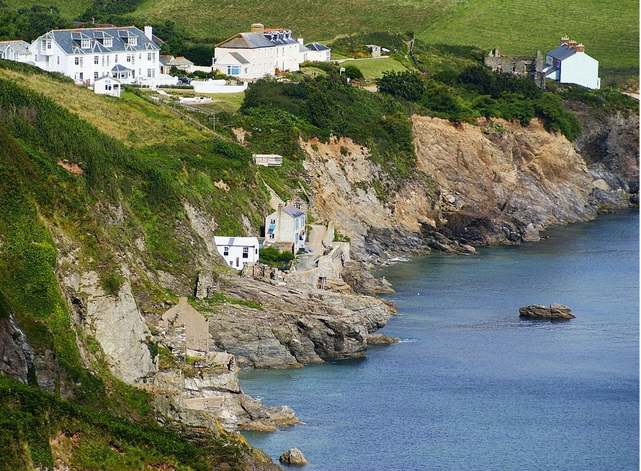
What are the lessons of Hallsands?
There are several lessons from the Hallsands disaster of 1917:
Coastal processes need to be observed, measured and understood – how is sediment moved along the coast and where does it come from?
Sea level change has in the past (and will in the future) affect coastal processes and landforms.
Peoples’ actions, whether dredging or coastal protection, can have impacts on natural coastal processes. These actions can contribute to disaster!

Slide 11
References
Images:
https://www.mediastorehouse.com.au/discover-images-by-awl/aerial-view-start-point-lighthouse-headland-20339359.html
https://www.bbc.co.uk/devon/content/image_galleries/hallsands_archive_gallery.shtml?2
https://www.sandsuckersuk.com/post/hallsands-the-first-suction-dredgers
https://www.southdevonaonb.org.uk/explore-start-bay/hallsands/#:~:text=Dredging%20and%20damage&text=Extracting%20it%20from%20Start%20Bay,of%201600%20tonnes%20per%20day.
https://commons.wikimedia.org/wiki/File:Ruins_at_Hallsands-10.jpg
Photos: P0515, P0178, and P0249 are courtesy of Kingsbridge Cookworthy Museum.
Some photos are courtesy of South West Coastal Monitoring and Geography Southwest.

Slide 12
www.southwest.coastalmonitoring.org
coastal.observatory@plymouth.ac.uk
01752 586155
www.geographysouthwest.co.uk
rosstrout@aol.com
@OfficialPCO
@geographysw_
PlymouthCoastalObservatory
Geographysouthwest
Plymouth.Coastal.Observatory

