Slide 1
The Dynamic Coast…..
…Where is Start Bay?
South West Coastal Monitoring in collaboration with Geography Southwest
Ppt. 1 of 4

Slide 2
Where is Start Bay?
Start Bay is located on the south coast of Devon, UK.
It stretches for about 15 km from Start Point in the south to Blackpool Sands in the north.
Whilst Start Point shelters the bay from the prevailing (most frequent) south-westerly winds, Start Bay is very exposed to winds blowing from the east.
There are two main beaches, Slapton Sands in the middle of the bay and Blackpool Sands at the northern end.
The beaches are separated by rocky outcrops exposed to the sea.

Slide 3
Start Bay, Devon
This is a more detailed map of Start Bay.
Notice that there is a main road that runs alongside the coast. This links the two towns of Dartmouth and Kingsbridge.
Locate South and North Hallsands, Beesands, Torcross, Slapton and Blackpool Sands. These places are all featured in these resources.
Notice there is only one country road that links the coastal villages together.

Slide 4
Headlands and bays
Headlands and bays are common landforms on the South Devon coast.
Start Point is an example of a headland.
Start Bay is an example of a bay.
Headlands and bays are formed when rocks of different strength are exposed at the coast. Weaker rocks are quickly eroded to form bays whereas more resistant rocks erode more slowly to form headlands.
Hard rock – erodes slower
Soft rock – erodes faster

Slide 5
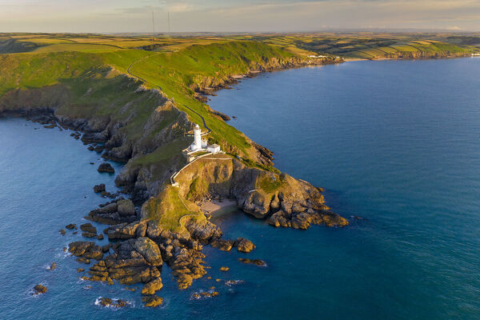
Start Point
This is a photo of Start Point and its famous lighthouse.
Resistant rocks exposed at the coast have formed this dramatic headland.
Notice the steep cliffs and exposed rocks at Start Point. No wonder there is a lighthouse here!
Notice that there is a small bay at the tip of the headland with a tiny sandy beach.
To the right of Start Point and the lighthouse is the broad curve of Start Bay.
Start Bay

Slide 6
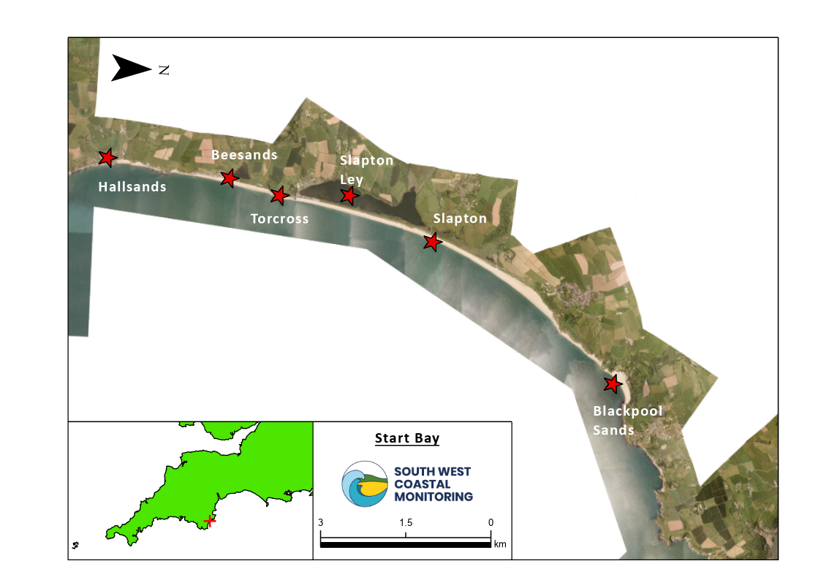
Start Bay
This horizontal aerial photography shows the coastal strip of land in Start Bay. The sea is at the bottom of the photo, shown in white.
Look at the North arrow. Notice that the photo has been rotated slightly from true north to fit the frame.
Notice that there is a wide beach extending across the bay with farmland behind it.
Locate Slapton Ley. Separated from the sea by a shingle ridge, this is the largest natural freshwater lake in the southwest.

Slide 7
Torcross and Slapton Ley
This photo shows the village of Torcross which is located at the southern end of Slapton Ley.
Notice the broad shingle beach on which part of the village has been built.
Torcross is exposed to the sea and at risk of flooding. Look closely to see that the village is protected by a seawall.
Slapton Ley is a protected area and a Site of Special Scientific Interest due to its community of plants and its importance for migrating birds.

Slide 8
Blackpool Sands
Blackpool Sands is a broad sandy beach enclosed within a small bay at the northern end of Start Bay.
In the summer it is extremely popular with tourists.
The bay is sheltered which explains the presence of a beach. Sediment is transported northwards by the dominant waves and deposited in the bay.
Over the last few years, the beach has gradually increased in size. We’ll find out why this has happened later!

Slide 9
References
Images:
https://kids.britannica.com/kids/assembly/view/243509
https://www.mediastorehouse.com.au/discover-images-by-awl/aerial-view-start-point-lighthouse-headland-20339359.html
https://www.visitsouthdevon.co.uk/things-to-do/slapton-ley-national-nature-reserve-p532333
https://en.wikipedia.org/wiki/Blackpool_Sands,_Dartmouth
Some photos are courtesy of South West Coastal Monitoring and Geography Southwest.

Slide 10
www.southwest.coastalmonitoring.org
coastal.observatory@plymouth.ac.uk
01752 586155
www.geographysouthwest.co.uk
rosstrout@aol.com
@OfficialPCO
@geographysw_
PlymouthCoastalObservatory
Geographysouthwest
Plymouth.Coastal.Observatory

