Slide 1
Hydrographs – GCSE resource pack
River Culm catchment
Teachers’ Notes

Slide 2
Hydrographs in the River Culm catchment
‘Hydrographs’ is a key topic studied within ‘River Landscapes’ at GCSE.
Students need to understand the two types of hydrograph (annual and flood), their characteristics (terminology) and the factors determining their shapes.
The River Culm catchment provides an excellent example of a small river basin with a characteristic ‘flashy’ hydrograph resulting in a high risk of flooding, particularly during winter months. During this time, soils are often saturated and fields are bare with little leaf coverage.
Nature-based solutions are being considered to address the river’s flashy response and reduce the risk of future flooding. The River Management PowerPoint looks at ways of reducing the risk of flooding through nature-based solutions.

Slide 3
Teaching resources
There are three sets of resources:
A PowerPoint presentation providing students with an illustrated study of the annual and flood hydrographs for the River Culm catchment.
An accompanying worksheet to provide students with a learning framework and record of their study. This can be completed on paper or electronically. Common exam command words have been used to support students’ preparation for exam questions.
This PowerPoint presentation providing Teachers’ Notes including data to enable students to construct a hydrograph for the River Culm (slide 4) and a completed hydrograph for the same date (slide 5). A selection of further activities and references are provided (slides 6-7).

Slide 4
Activity: constructing a hydrograph for the River Culm
Flood hydrograph: Cullompton (30/10/2008)
Plot the data for the flood hydrograph onto graph paper, with hours on the X axis and discharge in cumecs on the Y axis.
Draw a bar at 0 hours to show the rainfall (48mm). You will need to draw a separate Y axis to show rainfall.
Give your hydrograph a title and add these labels: rising limb, peak flow, falling limb.
Draw a line to show the lag time, and calculate the lag time in hours.
Hours | Discharge (cumecs)
0 | 2
5 | 5
10 | 20
15 | 100
20 | 137
25 | 60
30 | 30
35 | 18
40 | 15
45 | 10
50 | 8
55 | 7
60 | 5
Total rainfall: 48mm

Slide 5
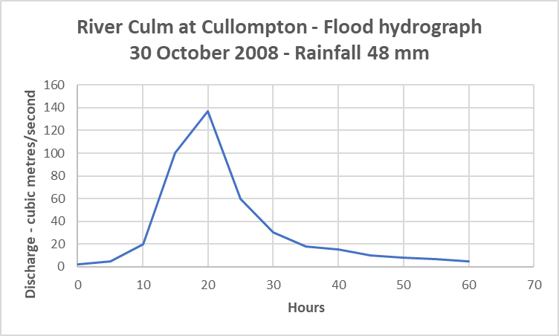
River Culm flood hydrograph – Cullompton 2008
The flood hydrograph shows how the river Culm responded to a storm that produced 48 mm rainfall in October 2008
The river rises rapidly, but also returns to low flow quite rapidly.
The Lag time is approx. 20 hours.

Slide 6
Further activities
Further activities may include:
Construct an annotated hydrological cycle diagram for the River Culm focusing on the characteristics of the River Culm catchment, for example, its geology and soils.
Evaluate the factors contributing to the Culm’s flashy response to winter rainfall.
Assess the possible impact of Culm Garden Village on the river’s storm hydrograph.
Suggest how the river’s flashy response could be reduced.
Use of the interactive gauging station graph for Culmstock (https://riverlevels.uk/river-culm-culmstock#.YQwSyYj0mUk) to investigate the annual flood hydrograph.

Slide 7
Use of hydrographs and hydrometric data
The Environment Agency and water companies use ‘hydrometric data’ (precipitation and discharge) and hydrographs to monitor rivers and flood risk and produce ‘real-time’ flood warnings.
Students can enter the River Culm, or a town like Cullompton on the website below and see data on the river level, and rainfall. They can also see the flood forecast for the next 5 days.
This activity would be particularly relevant during or immediately after a period of heavy rainfall.
https://flood-warning-information.service.gov.uk/warnings

Slide 8
References
Microsoft Word - 0007-UA005763-NER-01-CullomptonHydrologyReport (middevon.gov.uk) - Cullompton Eastern Distributor Road report – includes some rainfall and model hydrographs, from which hydrograph data was adapted. Copyright © 2015 Arcadis. All rights reserved. arcadis.com
exceptionally-wet-weather---november-2012---met-office.pdf (metoffice.gov.uk)
Journey along Culm from Uffculme to Culmstock - https://www.youtube.com/watch?v=hhN-gSE8lus
Https://connectingtheculm.com/discover-the-culm/

Slide 9
Hydrographs – GCSE resource pack
River Culm catchment
Student Slides

Slide 10
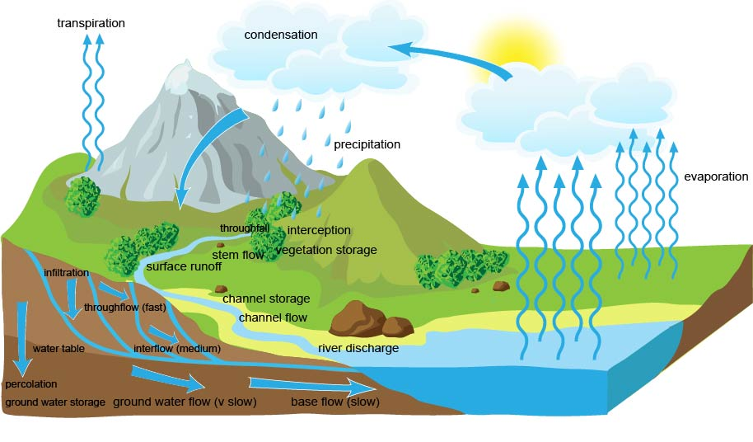
Drainage basin system and hydrographs
The drainage basin (catchment) system comprises inputs (e.g. precipitation), outputs (e.g. evaporation) and transfers (e.g. throughflow).
The size of stores and transfers varies according to individual drainage basin characteristics, such as geology, vegetation and urbanisation.
The river discharge can be shown on a hydrograph.
https://www.alevelgeography.com/drainage-basin-hydrological-system/

Slide 11
Drainage basins and hydrographs: terminology
Precipitation – input of water into the drainage basin as a transfer of water from the atmosphere to the ground (rain, snow, dew)
Evaporation – output of water from the drainage basin to atmosphere
Interception – precipitation intercepted most commonly by trees and plants
Surface runoff – water flowing over the ground surface
Infiltration – water soaking into the soil from the ground surface
Throughflow/interflow – water draining through the soil above the water table
Groundwater/base flow – water passing slowly through rocks
River discharge – volume of water (cubic metres/sec) flowing in a stream or river
Hydrograph – graph showing discharge of water in a river against time

Slide 12
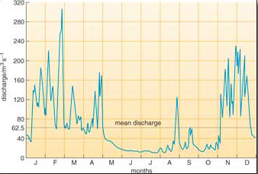
Annual and flood hydrographs
There are two types of hydrograph – the annual hydrograph and the flood hydrograph.
The annual hydrograph, or ‘river regime’, shows the mean discharge (in cubic metres per second or ‘cumecs’) of a river during a year, or several years.
It shows times when discharge is high, often during the winter, and when discharge is low, often in the summer.
Surface water: 2 River flow - OpenLearn - Open University - S278_14

Slide 13
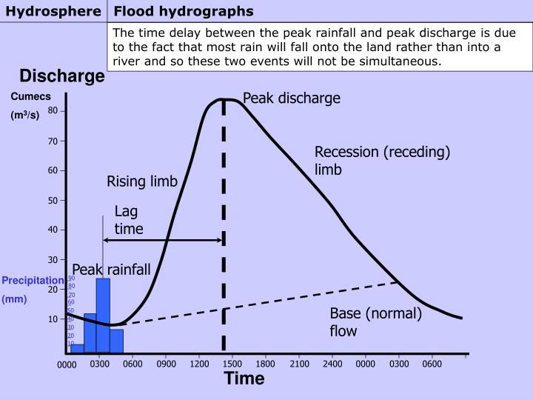
Annual and flood hydrographs
The flood hydrograph shows how river discharge responds to a short period of precipitation.
Flood hydrographs usually cover a period of hours or days, until river discharge returns to the normal flow (baseflow).
Flood hydrographs are important for flood control in showing how a river’s discharge responds to a storm event.
PPT - Flood hydrographs PowerPoint Presentation, free download - ID:1045243 (slideserve.com)

Slide 14
Flood hydrographs: terminology
Precipitation graph - the rainfall causing the river level to rise
River discharge – volume of water (cubic metres/sec) flowing in the river
Rising limb – the time period when the river level is increasing
Peak discharge –the maximum flow of the river for the rainfall event
Lag time – the time period from peak rainfall to peak discharge
Recession or falling limb – the time period when river levels are falling
Base flow – the “normal” discharge of the river, coming from water that has passed slowly through rocks

Slide 15
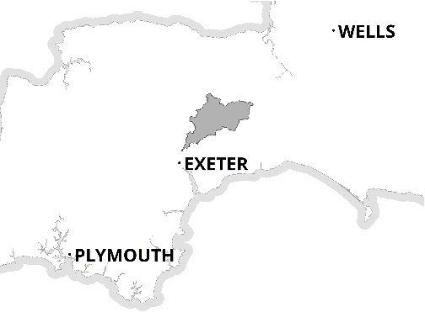
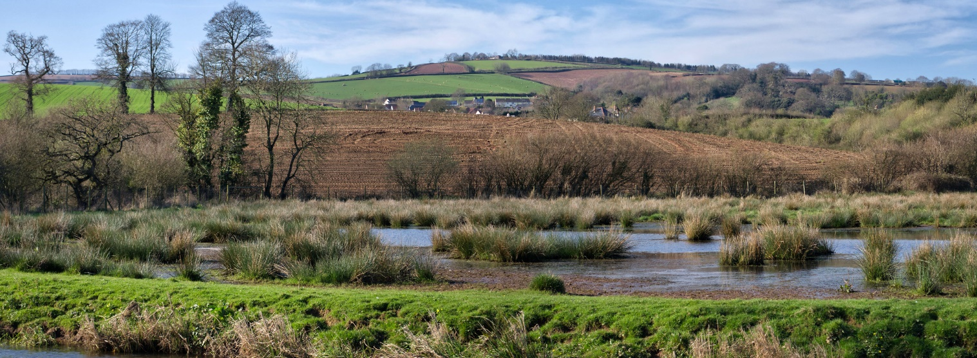
The River Culm drainage basin
The River Culm flows through the ‘Redlands’ of Mid and East Devon.
It is the longest tributary of the River Exe and drains an area of 280 square km. Mean annual rainfall is 970mm
The river rises at a spring near Culmhead in the Blackdown Hills. It flows through Hemyock and Cullompton to join the River Exe near Stoke Canon.
The catchment is 87% farmland, mostly pasture, 9% woodland and 4% Urban.
N
Culmhead
Stoke
Canon

Slide 16
Annual hydrograph (river regime)
The graph shows how the height of the river Culm at Culmstock varies from month to month and year to year.
The River Culm responds quickly to winter rainfall events, when soils are saturated and vegetation growth is minimal.
The usual height of the river is between 0.17m and 0.7m (the green line).
Highest level ever recorded is 2.17m (21 November 2012).
The graph shows winter discharge peaks when levels exceeded 0.7m.
https://riverlevels.uk/river-culm-culmstock#.YQwSyYj0mUk

Slide 17
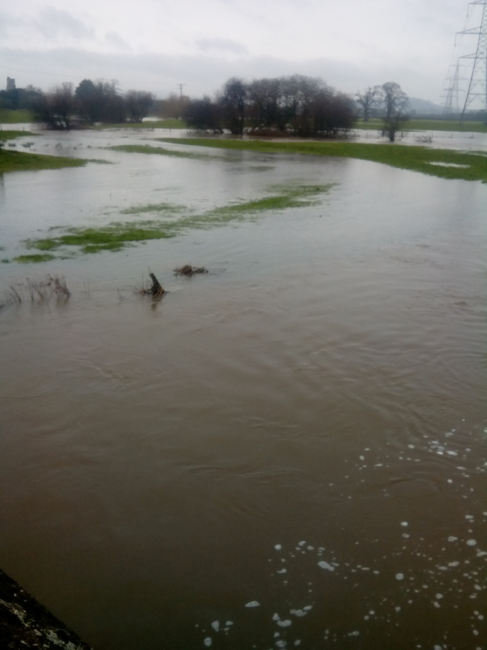
Winter flooding of the River Culm
There are several reasons why the River Culm is more likely to flood in winter:
There is less evapotranspiration from vegetation, and evaporation from surface water.
There is less interception of rainfall by vegetation which is not in leaf.
There is less infiltration as soils are saturated by autumn and winter rainfall.
Rainfall is often intense leaving no time to infiltrate and rainfall amounts are high.
Winter flooding near Stoke Canon

Slide 18
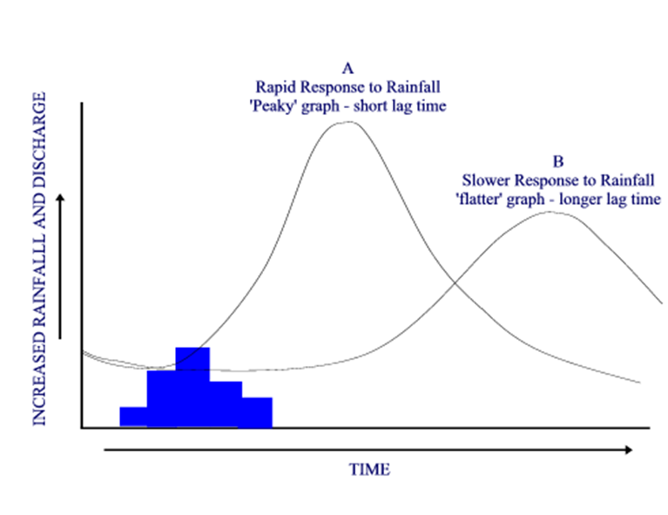
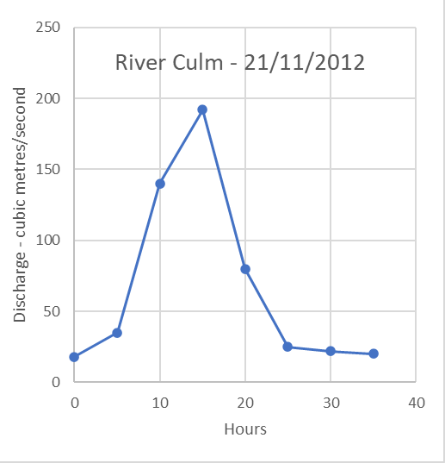
The River Culm – a ‘flashy’ river?
Flood hydrographs may be described as having a ‘flashy’ or peaky response to rainfall(A) or a slow-rise, lag response (B).
The graph below shows how the River Culm at Cullompton responded to a storm with 71 mm rainfall on 21/11/2012.
The river has a flashy response. Lag time is approx. 15 hours.
This storm followed a period of heavy rainfall in previous days.
The rainfall fell on saturated ground.
Floods affected Hele, Stoke Canon and Cullompton.

Slide 19
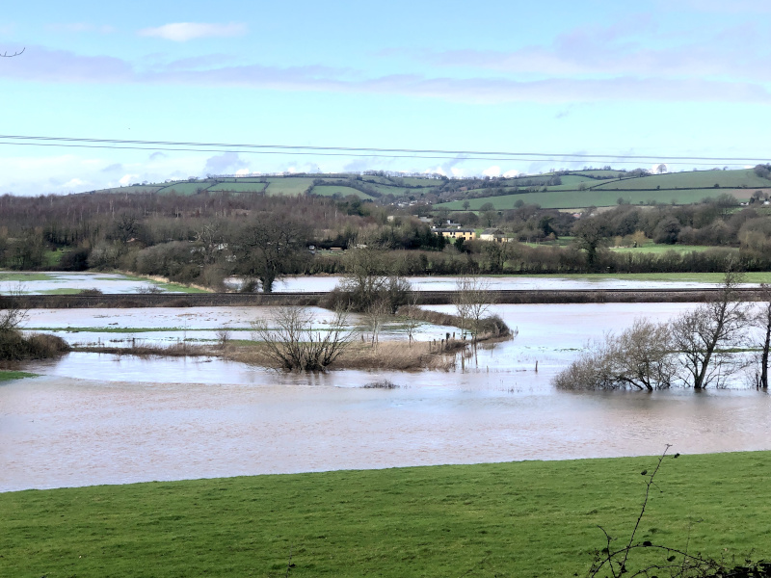
Why does the River Culm have a flashy hydrograph?
Flooding near Killerton after heavy rainfall
The Culm respond quickly to significant rainfall events in autumn and winter because:
Shallow soils and impermeable clays in the Upper Culm quickly become saturated, leading to runoff.
Heavier clay soils are compacted by livestock farm machinery harvesting autumn crops like maize or spreading slurry, reducing infiltration.
Steep slopes on the Blackdown Hills generate rapid surface runoff.
Urban areas: impermeable surfaces in urban areas lead to increased runoff.
https://connectingtheculm.com/climate-change-and-the-river-culm/

Slide 20
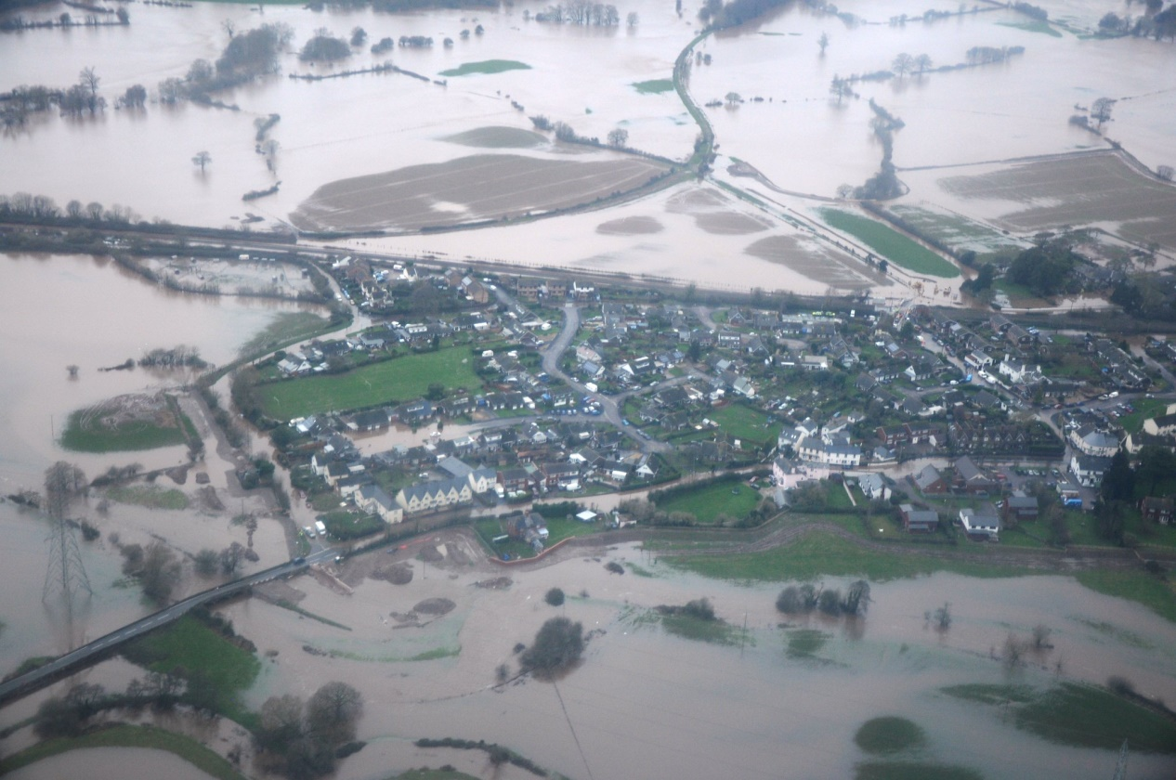
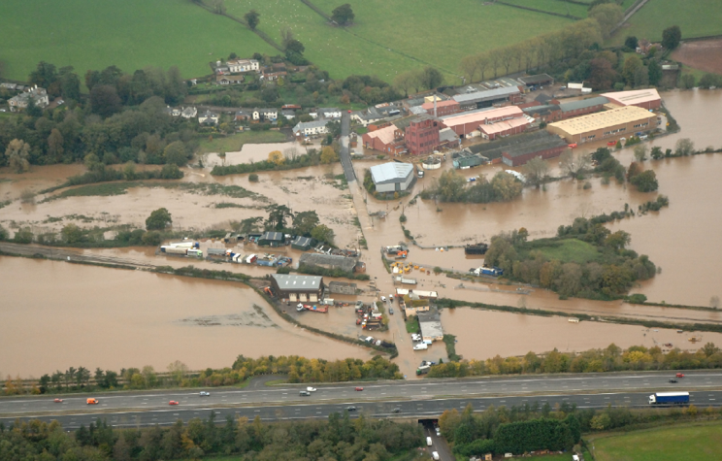
Flooding - Stoke Canon and Hele (2012)
Flooding at Stoke Canon damaged houses, flooded roads and disrupted transport. Some people had to be evacuated.
Flooding at Hele resulted in the temporary closure of the mainline railway connecting the south-west to the rest of the UK. Property and industrial premises were inundated.
Aerial view of flooding around Silverton village, Devon | Flickr
https://connectingtheculm.com/climate-change-and-the-river-culm/

Slide 21
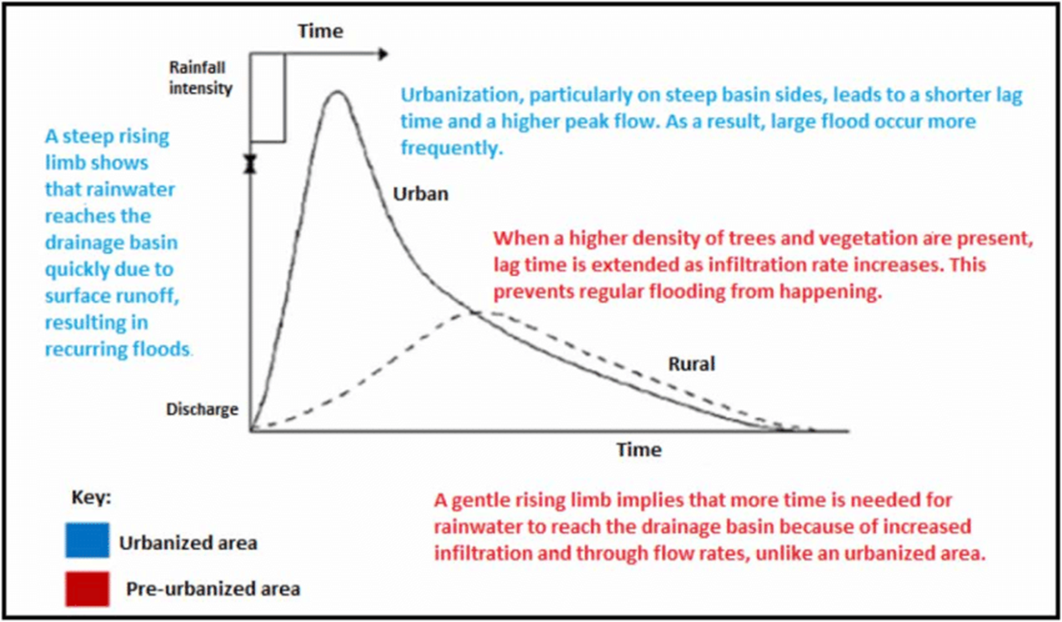
Effects of urbanisation on the hydrograph
The graph shows the differences in hydrographs between an urban and a rural area.
The risk of flooding tends to be higher in urban areas where impermeable surfaces speed water transfer, increasing the peak and reducing the lag time.
Further urbanisation is planned in the River Culm catchment, including a new garden village close to Cullompton.
Flood hydrograph before and after urbanisation (source: Dams et al.... | Download Scientific Diagram (researchgate.net)

Slide 22
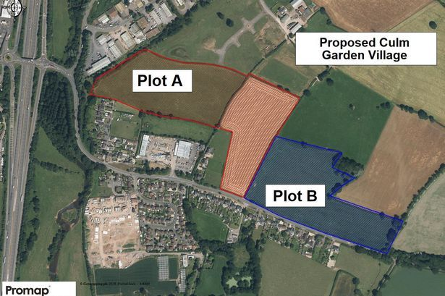
Culm Garden Village - Cullompton
In 2017, the government announced plans for the Culm Garden Village in Cullompton.
It will provide up to 5,000 new homes together with shops, employment, schools and health care facilities.
Urbanisation can increase surface runoff by replacing permeable surfaces with concrete and tarmac.
Sustainable Drainage Systems (SuDs) provide ways of managing runoff in new development areas and reducing risk of floods.
https://www.devonlive.com/news/devon-news/culm-valley-garden-village-300k-2555847

Slide 23
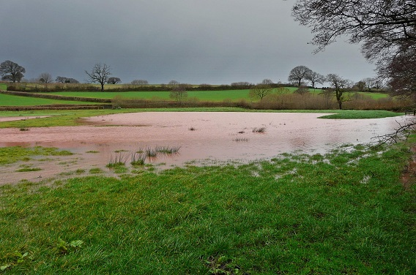
Reducing flood peaks on the River Culm
Flood water storage using bunds at Holnicote Estate
Nature-based solutions can slow the flow of water through the catchment:
Planting trees and managing woodland to increase interception and infiltration
Restoring natural channels on the flood plain to create wetland storage
Encouraging farmers to manage soils and land use to increase infiltration and storage
Building bunds (earth banks) to protect areas at risk and hold back water
Encouraging leaky barriers on streams to slow down discharge
https://connectingtheculm.com/discover-the-culm/

Slide 24
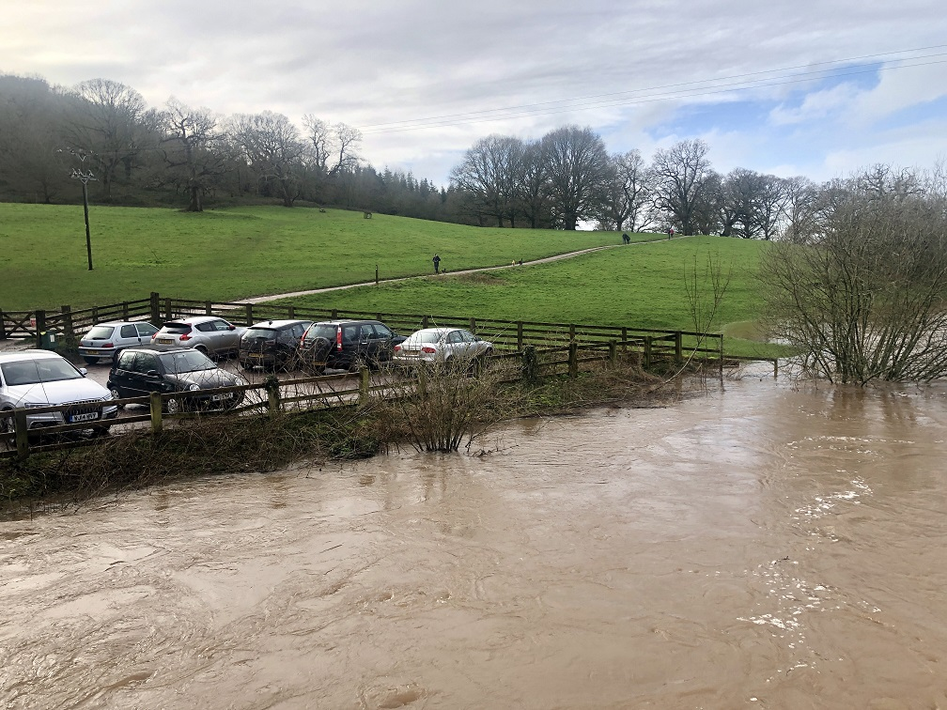
Climate change and the annual hydrograph
Flooding at Killerton
Climate change is having an impact in the South West. In the future, it may increase flood risk by reducing lag times and creating higher peaks.
Average annual rainfall is 10% higher in 2021 than in 1961.
Rainfall is becoming more seasonal, with a an increase in autumn rain by 28% and winter rain by 16%.
By 2080, winter rainfall is expected to increase by 20-50%.
https://connectingtheculm.com/discover-the-culm/

Slide 25
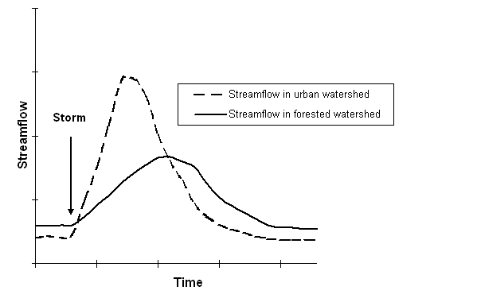
Alternative simpler diagram for slide 13
Cornell University - Environmental Inquiry - Roadside Ditch Projects (cornell.edu)

