Slide 1
Flood Management – GCSE resource pack
River Culm catchment
Teachers’ Notes

Slide 2
Flood management in the River Culm catchment
Flood management is a key topic studied within ‘River Landscapes’ at GCSE.
Students need to understand the causes of floods and their contributory factors and appreciate the hard and soft (nature-based) engineering options in addressing the issues.
The River Culm catchment provides an excellent example of a small river basin that has been prone to serious flooding for many years. A range of hard and soft engineering solutions have been adopted with an increasing emphasis on soft, nature-based solutions which are considered to be more sustainable.

Slide 3
Teaching resources
There are three sets of resources:
A Powerpoint presentation providing students with an illustrated study of the issues and solutions associated with flood management in the River Culm catchment.
An accompanying worksheet to provide students with a learning framework and record of their study. This can be completed on paper or electronically. Common exam command words have been used to support students’ preparation for exam questions.
This PowerPoint presentation providing Teachers’ Notes including a selection of activities and references (slides 4-7).

Slide 4
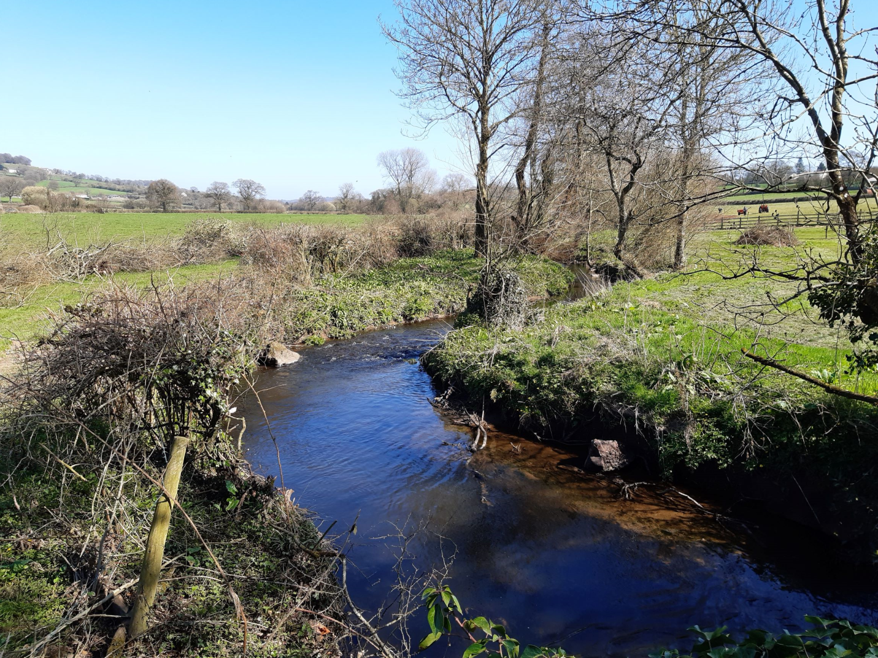
Activity: Using the photo, evaluate the ways that the river and its flood plain could be adapted to reduce the flood risk.
(Culm SR 01)

Slide 5
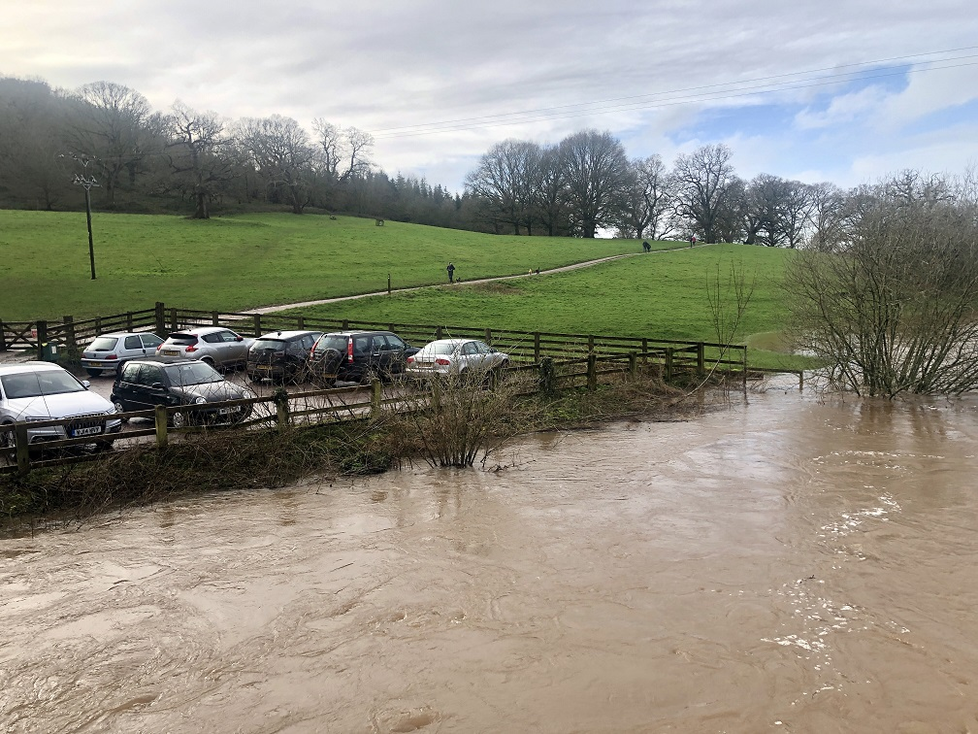
Activity: Using the photo, explain why climate change may increase the risk of flooding in the future.
Flooding at Killerton
https://connectingtheculm.com/discover-the-culm/

Slide 6
Activities
Further student activities may include:
Explain why the River Culm floods.
Suggest the impacts of flooding on people, property, farming and transport systems.
Describe examples of hard engineering and evaluate the advantages and disadvantages of this type of flood management.
Explain how nature-based solutions can reduce the risk of flooding.
Assess how nature-based solutions may support biodiversity in the river channel and in the river valley.
Explain how river restoration at Silverton Mill will reduce the flood risk.
Suggest the possible impacts of Culm Garden Village on flood risk. How might SUDs mitigate the problem?

Slide 7
References
Two useful videos:
Journey along the Culm from Uffculme to Culmstock Journey along Culm from Uffculme to Culmstock
https://www.youtube.com/watch?v=hhN-gSE8lus
Aerial Dimensions Https://connectingtheculm.com/discover-the-culm/
Case studies of Silverton Mill can be found here:
https://insideecology.com/2017/12/05/silverton-mill/
https://www.johnfhuntregeneration.co.uk/silverton-mill/
Descriptions of Sustainable Drainage Systems (SuDS) can be found here:
https://www.susdrain.org/delivering-suds/using-suds/background/sustainable-drainage.html
(provides a clear summary and useful diagrams and images)
http://www.hidrologiasostenible.com/sustainable-urban-drainage-systems-suds/
https://nerc.ukri.org/planetearth/stories/1751/

Slide 8
Flood Management – GCSE resource pack
River Culm catchment
Student Slides

Slide 9
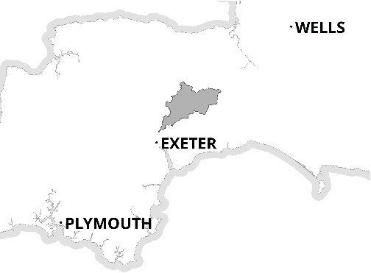
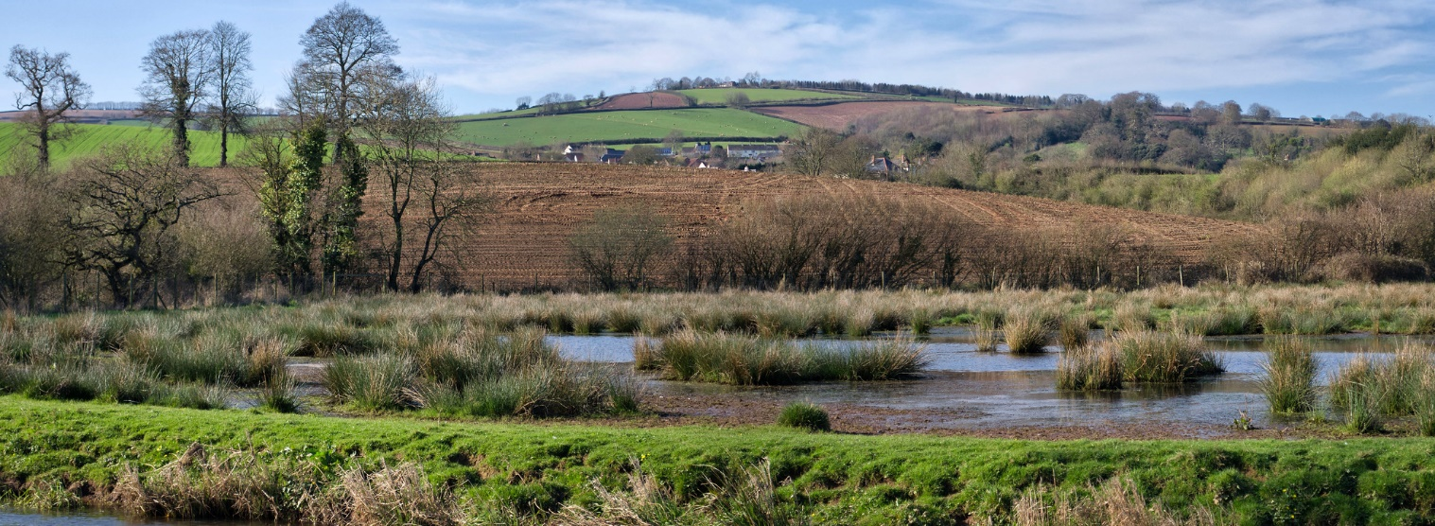
The River Culm drainage basin
The River Culm flows through the ‘Redlands’ of Mid and East Devon.
It is the longest tributary of the River Exe and drains an area of 280 square km.
The river rises at a spring near Culmhead in the Blackdown Hills. It flows through Hemyock and Cullompton to join the River Exe near Stoke Canon.
The catchment is predominantly rural, comprising mixed woodland and agricultural (mostly pasture).
N
Culmhead
Stoke
Canon

Slide 10
River Culm catchment: land use
The majority of the Culm catchment is agricultural (87%) comprising improved grassland (62%) and arable (25%).
Intensive agriculture can lead to soil compaction increasing the flood risk.
Woodland covers 9% of the catchment
Urban and suburban land uses comprise about 4% only, however, impermeable surfaces and drains can exacerbate the local flood risk.
Add scale

Slide 11
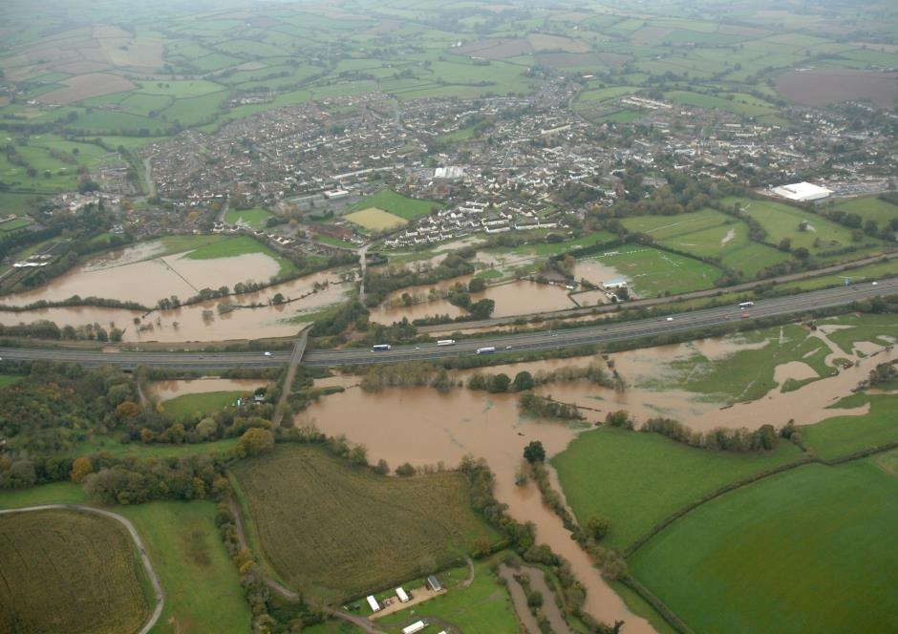
Flood risks on the River Culm
The River Culm has a long history of flooding. The flood plain between Cullompton and Stoke Canon is flooded 5 to 7 times most winters.
Rivers are supposed to flood their flood plains! Problems arise when people, property and transport are in the way.
Floods in 2012 affected 47 residential and industrial properties in Cullompton and houses in Stoke Canon.
Floods damaged property in Cullompton in 1980, 1989, 1997, 1999, and 2008.
The railway at Hele was flooded in 2008 and 2012.
Cullompton floods – Environment Agency

Slide 12
Why does the River Culm flood?
Geology/soils: Shallow soils in the Upper Culm sit over impermeable clays which quickly become saturated, leading to runoff.
Land use and soils: 87% of the Culm catchment is farmland. Heavier clay soils are at risk from compaction from livestock and by farm machinery harvesting autumn crops like maize or spreading slurry. This reduces infiltration.
Slopes: Rapid runoff occurs on the steep slopes of the Blackdown Hills when the water table is high.
Urban areas: Impermeable surfaces in urban areas lead to increased runoff.
Culm floods near Hele and Compacted Soil, River Culm – https://wrt.org.uk/wp-content/uploads/2019/07/culm-flood-feb-2016-3.jpg and Connecting the Culm

Slide 13
Flood risks – effects of recent floods
The London to Exeter and Plymouth railway line flooded at Hele in 2002, 2008 and 2012, disrupting passenger and freight traffic for several days.
Farmers have to move livestock, and winter crops may be affected.
Industrial and residential property can be damaged by floodwater and contaminated by sewage and pollutants.
https://connectingtheculm.com/climate-change-and-the-river-culm/

Slide 14
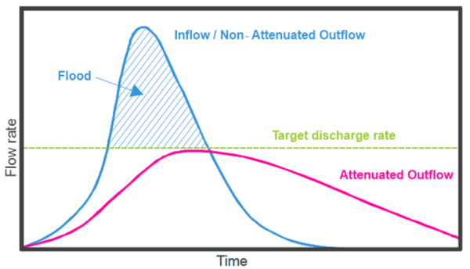
Flood management methods
Flood management aims to reduce the river flow to a targeted discharge that will keep people and property safe.
The aim is to attenuate (reduce) the river flow through hard engineering or nature-based flood management.
Blog (celticwater.co.uk)

Slide 15
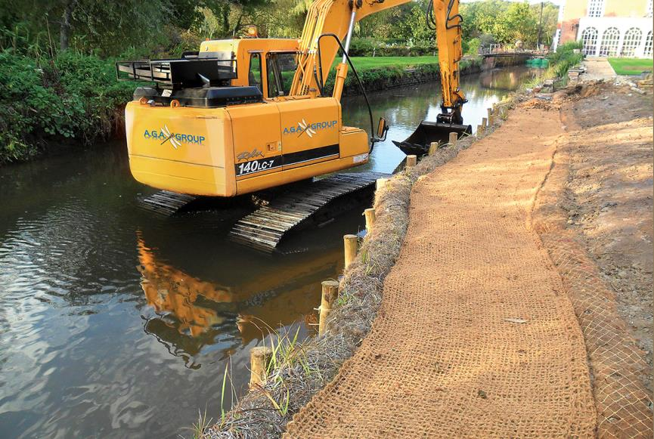
Flood management methods – hard engineering
Hard engineering flood management aims to keep people, property and transport safe from flooding. Examples include:-
Holding back flood water either behind dams or in creating flood retention basins behind embankments.
Deepening, widening and straightening river channels to increase capacity.
Creating flood relief channels to take water past endangered areas.
Protecting areas from river erosion using concrete or gabions (stones in wire baskets)
Lake Management & Erosion Control Materials AGA Group | Aquatic Engineering Service

Slide 16
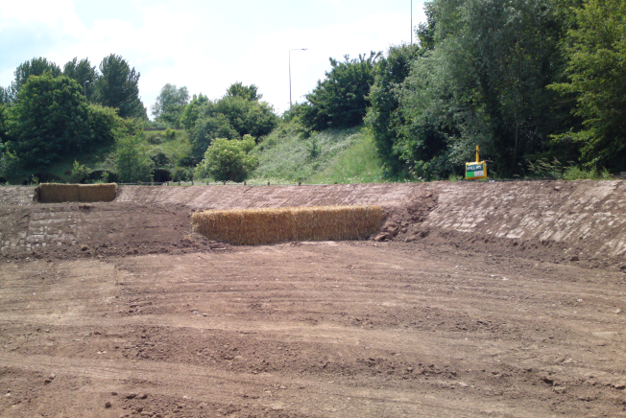
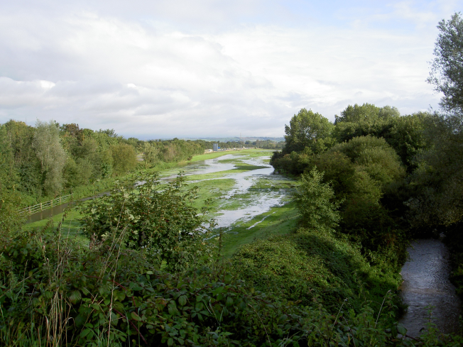
Culm flood management - hard engineering
Cullompton Flood channel (1968) was built to recreate part of the Culm flood plain lost when the M5 motorway was built. It takes floodwater past the east side of the town.
It was dredged and rebuilt in 2011 in an award winning scheme by Balfour Beatty.
At Stoke Canon, 1200 m of flood banks (bunds) and a 150m flood wall were constructed in 2012 to protect 100 properties in the village.
https://www.ceequal.com/case-studies/cullompton-flood-channel/

Slide 17
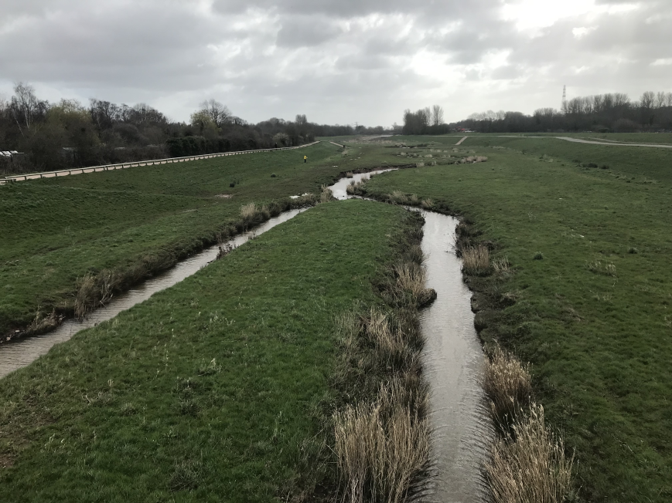
Flood management: nature-based solutions
Nature-based solutions slow the flow of water through the catchment and include:
Planting trees and woodland management to increase interception and infiltration.
Restoring natural channels in the river and on the flood plain to create wetland storage.
Encouraging farmers to manage soils and land uses to increase infiltration and storage.
Building bunds (earth banks) to protect areas at risk.
Encouraging leaky barriers on streams.
Nature-based solutions create space for wildlife, and reduce risk of droughts by encouraging baseflow.
Flood plain storage – River Exe flood plain
Image source: John Davidson

Slide 18
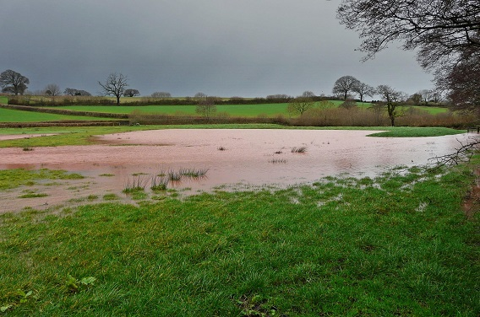
Nature-based solutions – slowing runoff
Flood water storage using bunds at Holnicote Estate
Bunds can help to store water during high rainfall.
Slow moving water deposits sediment which enriches the soil for agriculture.
Bunds create important wetland habitats for wildlife and promote biodiversity.
https://connectingtheculm.com/discover-the-culm/

Slide 19
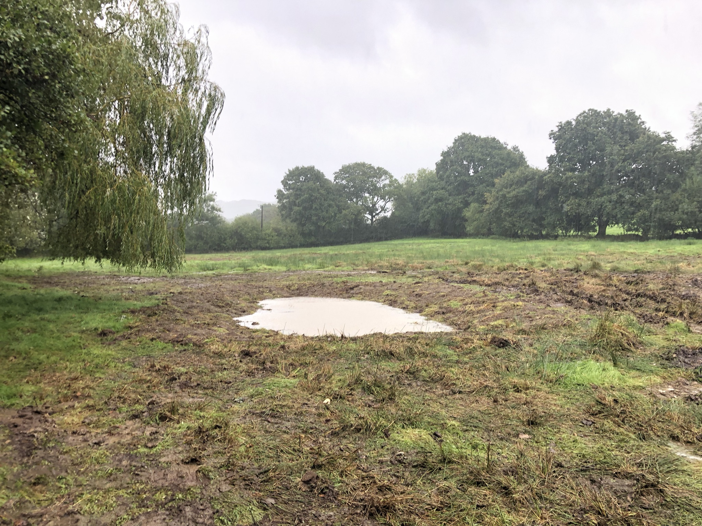
Nature-based solutions – scrapes
Scrapes are shallow depressions with gently sloping edges, which seasonally hold water.
Scrapes slow the flow and store flood water reducing flood risk downstream.
Scrapes allow sediments to drop out improving water quality.
Tree planting helps create surface roughness, to slow the flow of water.
Scrapes benefit wildlife by attracting a more diverse range of flora and fauna.
A new scrape on the Culm after a few weeks with smooth edges and water, waiting for wildlife.
https://connectingtheculm.com/discover-the-culm/

Slide 20
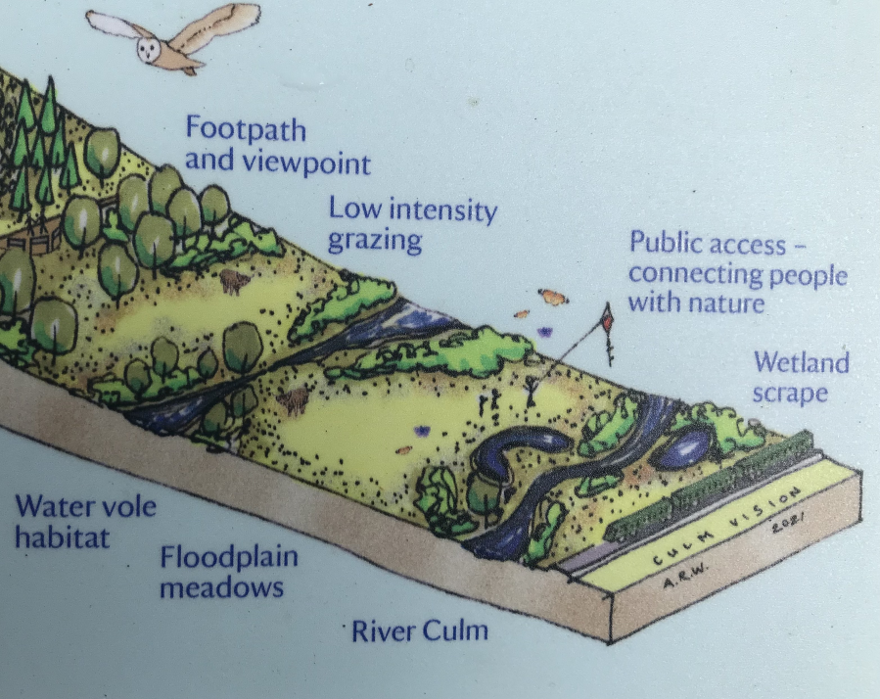
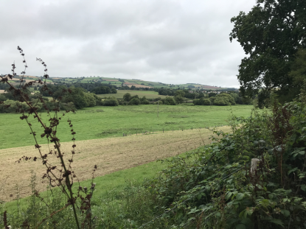
Nature-based solutions: floodplain restoration
Recreating the original course of a river, allowing it to meander across its flood plain. This slows down water transfer reducing the risk of flooding downstream.
Creating wetland ‘scrapes’ (excavated hollows), increasing water storage and encouraging wildlife.
The Culm – a 50-year vision – Ellerhayes to Columbjohn – Connecting the Culm

Slide 21
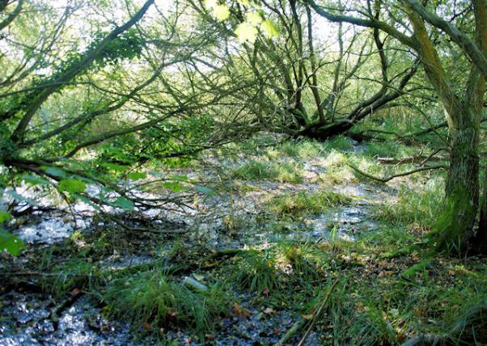
Nature-based solutions – woodland management
Natural wet woodland habitat in the Upper Culm
Tree planting – soils in woodlands are 67 times more absorbent to water than compacted soils due to dense root networks and a deep humus layer.
Heathland and woodland restoration, including wet woodlands helps increase soil permeability and encourages wildlife.
https://connectingtheculm.com/discover-the-culm/

Slide 22
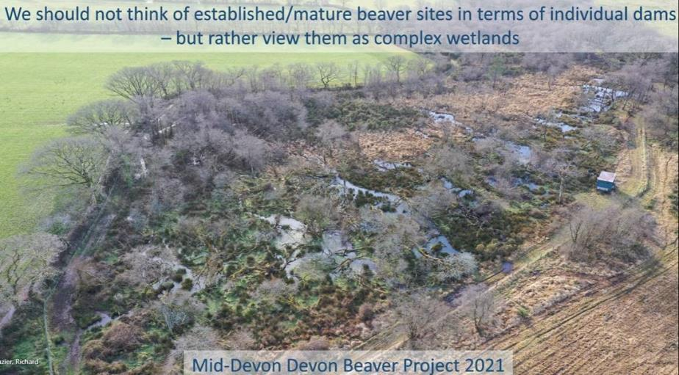
Nature-based solutions: leaky barriers and beavers
Leaky barriers in the river channel such as tree debris help to slow runoff. Beavers dams are ideal leaky barriers.
Beavers breed on the River Otter which adjoins the Culm catchment. Their dams hold back water in ponds, releasing it slowly to create a constant flow. These wetland areas promote biodiversity.
During storms, peak flows on streams where beavers live are 30% lower, and lag times longer. The water is also less silty.
Photo – Eurasian Beaver – Devon Wildlife Trust

Slide 23
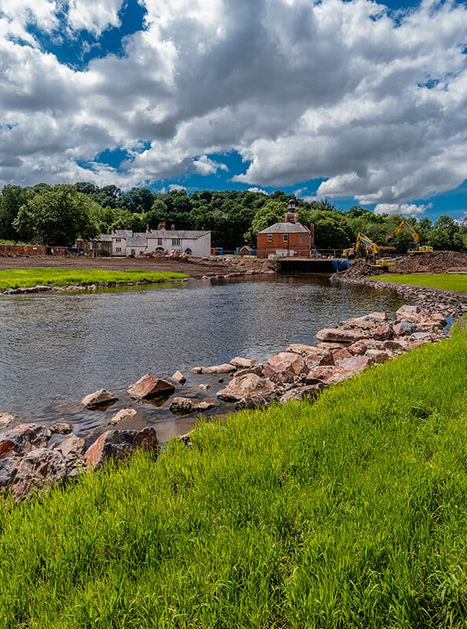
Silverton Mills – river restoration
The Award winning Silverton Mill scheme (2017) restored a section of the River Culm following demolition of a derelict paper mill. Work included:
Creating a new wider river channel.
Protecting lower ground and property with a new flood defence embankment.
Enhancing water storage in the channel and on the flood plain to reduce flood risks.
Protecting banks from erosion by gabions.
Removal of contaminated silt in the river.
Increasing wildlife diversity.
Silverton Mill - John F Hunt Regeneration

Slide 24
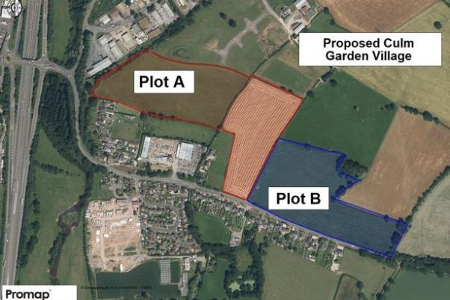
River Culm catchment – increasing urbanisation
In 2017, the government announced plans for the Culm Garden Village in Cullompton.
It will provide up to 5,000 new homes together with shops, employment, schools and health care facilities.
Urbanisation can increase surface runoff by replacing permeable surfaces with concrete and tarmac.
Sustainable Drainage Systems (SuDS) provide ways of managing runoff in new development areas.
https://www.devonlive.com/news/devon-news/culm-valley-garden-village-300k-2555847

Slide 25
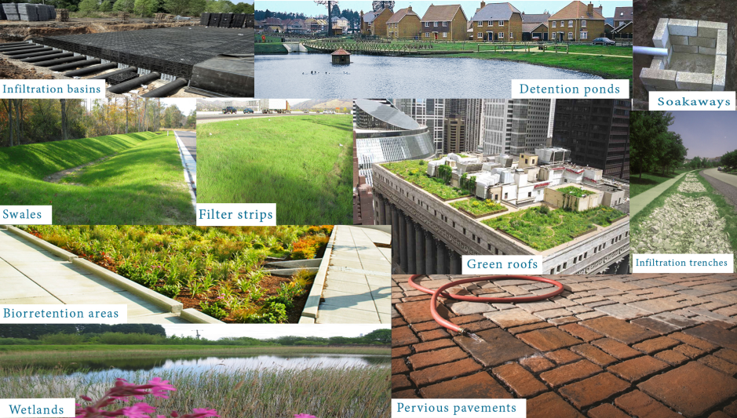
Sustainable Drainage Systems (SuDS)
Sustainable Drainage (SuDS) helps reduce surface runoff from urban areas like the proposed Culm Garden Village.
Infiltration in the soil, and water storage is encouraged.
The diagram shows ten ways that runoff can be reduced by sustainable urban drainage systems.
Sustainable Urban Drainage Systems – SUDS – Hidrología Sustainable (hidrologiasostenible.com)

Slide 26
Will climate change increase the risk of flooding?
Flooding at Killerton
Climate change is already having an impact in the South West:
Average annual rainfall is 10% higher in 2021 than in 1961.
Rainfall is becoming more seasonal, with a an increase in autumn rain by 28% and winter rain by 16%.
By 2080, winter rainfall is expected to increase by 20-50%.
https://connectingtheculm.com/discover-the-culm/

