Slide 1
Carbon Cycle – A-level resource pack
River Culm catchment
Teachers’ Notes

Slide 2
The carbon cycle in the River Culm catchment
The carbon cycle is a key topic studied at A level.
Students need to understand the components and mechanisms associated with the global carbon cycle and its applications at the regional and local scale.
Rivers and catchments play an important part in the carbon cycle, providing stores and transfer processes.
The River Culm catchment provides an excellent example of a small rural river basin with carbon stores and transfer processes that are responsible for constant carbon fluxes.
There are significant opportunities for carbon sequestration in the face of the challenges associated with climate change.

Slide 3
Teaching resources
There are two sets of resources:
A Powerpoint presentation providing students with an illustrated study of the carbon cycle focusing on the River Culm catchment. The presentation begins with an overview of the global carbon cycle before focusing on the specific role of river catchments in providing carbon stores and transfer mechanisms. The River Culm catchment in Devon forms an extended local case study.
This Powerpoint presentation providing Teachers’ Notes including a selection of activities and references (slides 4-8).

Slide 4
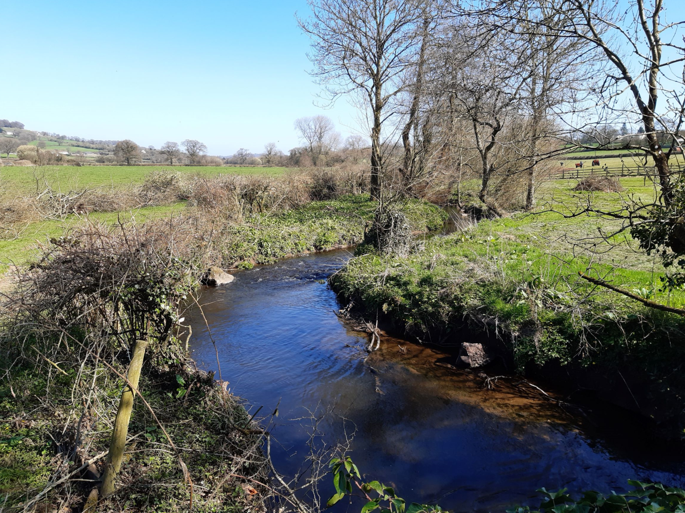
Activity: Using the photo, assess the carbon stores and fluxes associated with human use and management of the River Culm.
(Culm SR 01)

Slide 5
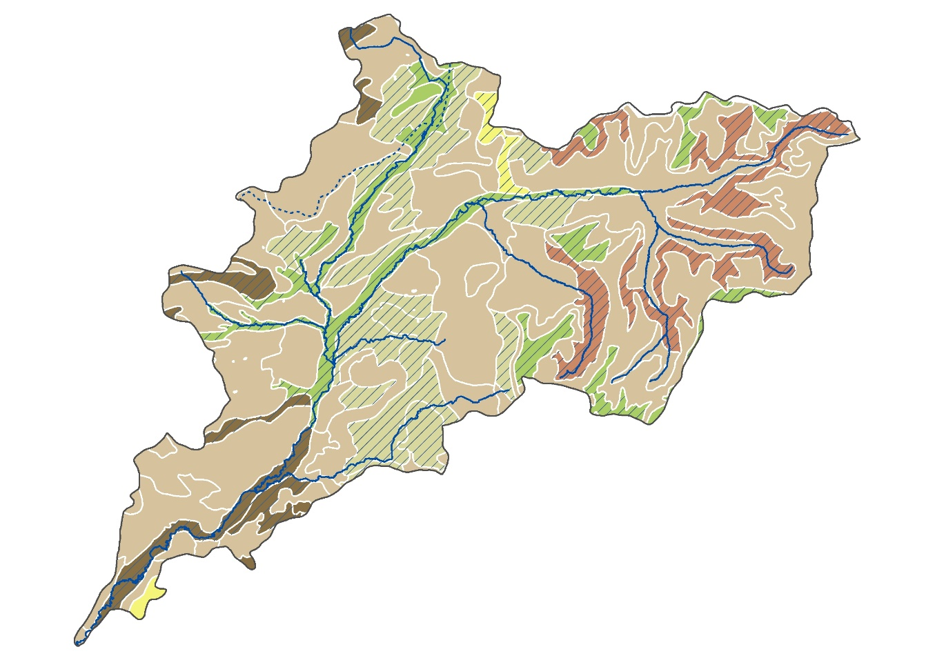
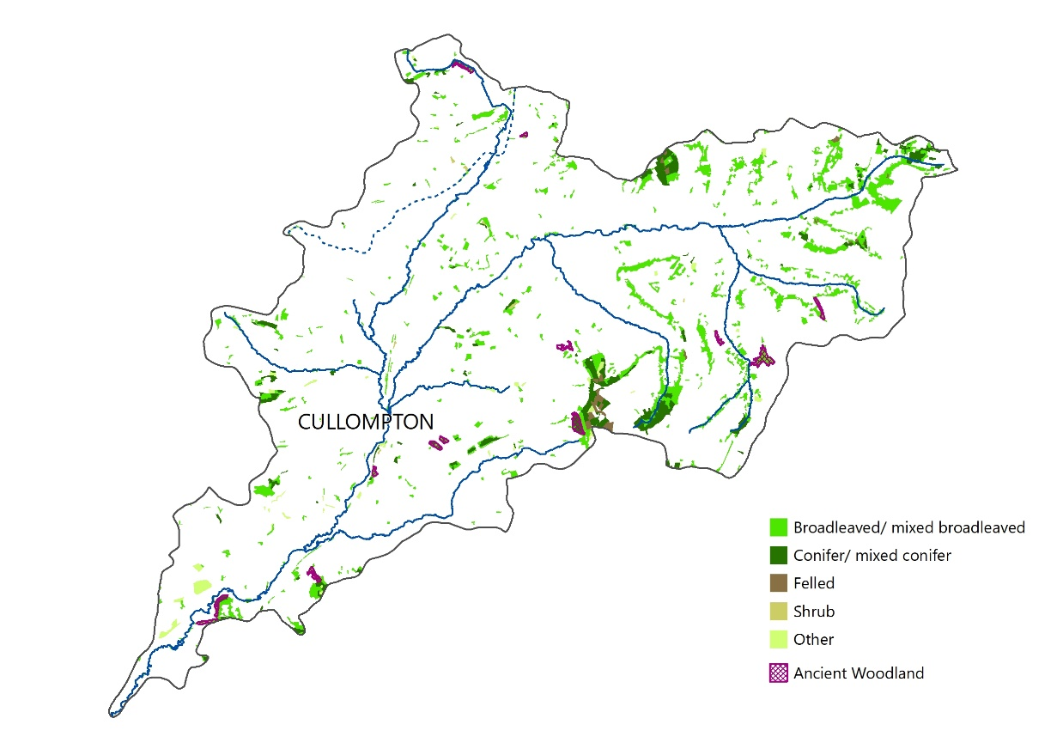
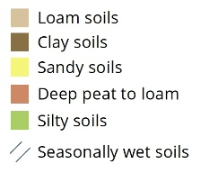
Activity: With reference to the maps below showing the distribution of woodland and soils, discuss the opportunities for carbon storage in the Culm catchment.

Slide 6
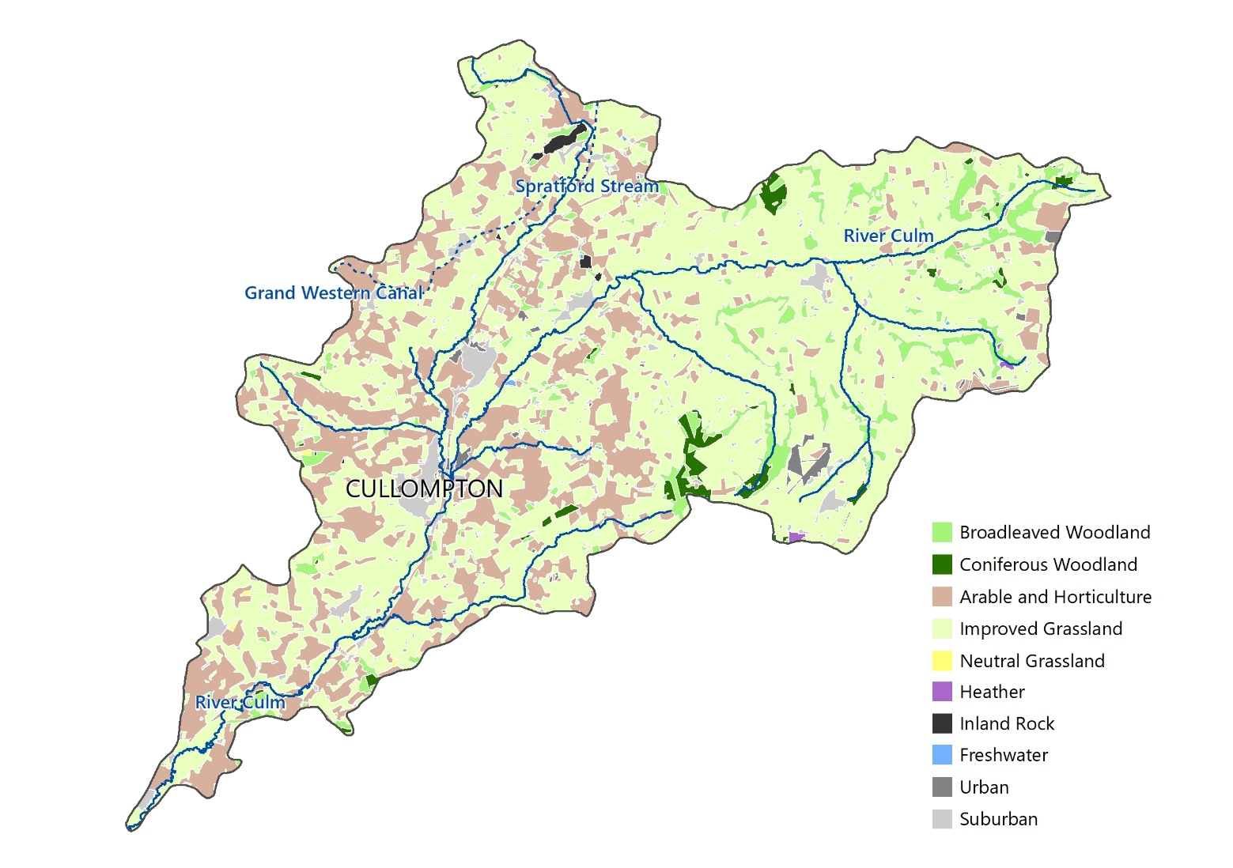
Activity: Using the maps below, describe and suggest reasons for the variations in carbon storage in soils and vegetation in the Culm catchment.

Slide 7
Activities
Further student activities may include:
Using a simple diagram, outline the role of river basins within the global carbon cycle.
Assess the relative importance of the carbon stores and transfer processes (fluxes) within a river basin.
Identify the main carbon stores in the River Culm catchment.
Explain how carbon is released within the River Culm catchment.
Assess the importance of (a) planting trees and, (b) restoring wetlands in capturing carbon in the River Culm catchment.
Outline the Connecting the Culm model and assess its value as a local community template for addressing issues of carbon capture and storage in river catchments.
Geography NEA
There are several opportunities for individual research enquiries focusing on the carbon cycle in small river basins such as the River Culm. For example, the carbon storage of trees can be calculated and extrapolated for areas within a river catchment. Soil carbon content can be measured and compared and the role of peat (through depth measurements) can also be assessed. (See https://www.geography-fieldwork.org/a-level/water-carbon/carbon-cycle/method/ for further details).

Slide 8
References
The Connecting the Culm online library has an extensive range of useful information at https://connectingtheculm.com/library/
The very extensive Connecting the Culm Environmental Evidence Review (2021) is the primary source for some aspects of the student Powerpoint presentation at https://connectingtheculm.com/discover-the-culm/
For general information on the carbon cycle, NOAA has an excellent collection of materials at https://www.noaa.gov/education/resource-collections/climate/carbon-cycle . All A level textbooks and many online A level support sites provide additional information on the carbon cycle.
Forest Research considers the role of trees at https://www.forestresearch.gov.uk/tools-and-resources/statistics/forestry-statistics/forestry-statistics-2018/uk-forests-and-climate-change/carbon-cycle/
For suggestions to support NEA enquiries, see the Field Studies Council website at https://www.geography-fieldwork.org/a-level/water-carbon/carbon-cycle/method/

Slide 9
Carbon Cycle – A-level resource pack
River Culm catchment
Student slides

Slide 10
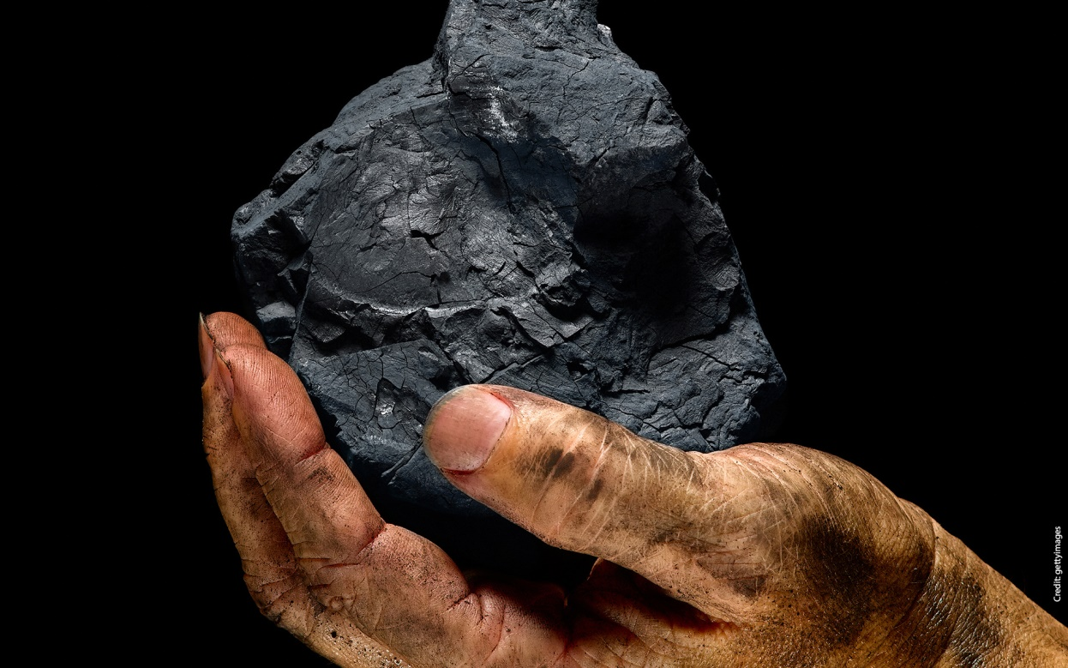
What is carbon?
Carbon, along with nitrogen and oxygen, is one of the essential building blocks of organic life.
It is a basic chemical element – along with nitrogen, phosphorus and sulphur – required by all living things in order to survive.
Carbon enables energy to be created to fuel industrial development.
Major carbon stores include the oceans, ocean sediments, soils, sedimentary rocks, fossil fuel deposits, vegetation and the atmosphere.
https://www.man-es.com/discover/decarbonization-glossary---man-energy-solutions/carbon---decarbonization-glossary-man-energy-solutions

Slide 11
Where is carbon stored?
Carbon store | Amount in petagrams | Key points
Earth’s crust (including sedimentary rocks and marine sediments) | 100,000 | Long-term store; rocks take millions of years to form.
Oceans | 38,000 | Absorbs carbon dioxide direct from the air; river discharges flush dissolved carbon and particulates into oceans.
Fossil fuel deposits | 4,000 | Hydrocarbons such as coal and oil are long-term stores. Combustion (fuel) is major source of carbon dioxide in the atmosphere.
Soil organic matter | 1,580 | Carbon stored in decomposed organic matter (humus); carbon can be released by deforestation and soil erosion.
Atmosphere | 750 | Carbon held in the atmosphere in the form of carbon dioxide and methane. Amounts of these greenhouse gases have increased due to combustion of fossil fuels, deforestation, cattle rearing, etc.
Terrestrial biomass (plants and animals) | 610 | Plants use carbon dioxide in the process of photosynthesis; carbon can be stored or transferred to the soil. Deforestation releases carbon back to the atmosphere.

Slide 12
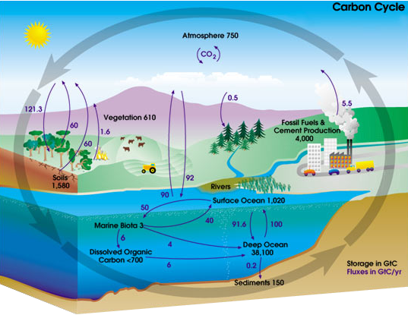
What is the carbon cycle?
The processes involved in transferring carbon between the stores are known as transfers.
These are the inputs and outputs that continually alter the magnitude of the stores.
Carbon within the carbon cycle is in a constant state of flux, hence the term ‘flux’ to describe transfers between stores.
The timescale of these changes ranges from a few minutes (e.g. wildfire) to millions of years (e.g. fossil fuel formation).
https://earthhow.com/carbon-cycle/

Slide 13
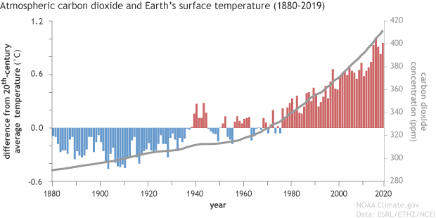
Carbon emissions and the greenhouse effect
Carbon emissions have increased significantly since the 1880s mainly due to the combustion of fossil fuels.
Carbon emissions (carbon dioxide and methane) also occur through deforestation, rearing cattle and soil erosion.
Carbon dioxide and methane are ‘greenhouse gases’, absorbing heat in the atmosphere and contributing to global warming and climate change.
https://www.climate.gov/news-features/climate-qa/if-carbon-dioxide-hits-new-high-every-year-why-isn%E2%80%99t-every-year-hotter-last

Slide 14
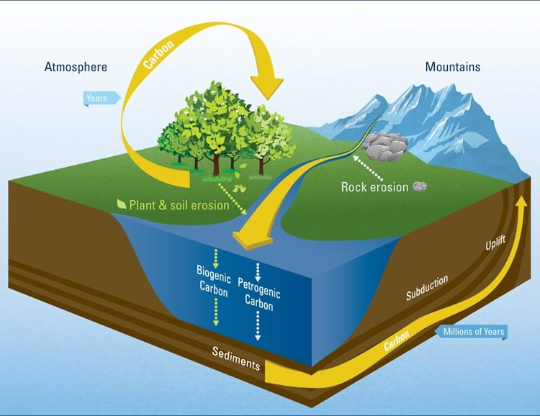
Rivers and the carbon cycle
Rivers flush carbon from the land to the ocean, reducing carbon emissions to the atmosphere.
Rivers carry decomposed organic (biogenic)carbon to the sea.
Rivers erode rocks. Exposed carbon may be oxidised and released to the air or transported as petrogenic carbon to the sea.
Over millions of years, sediments on the seabed may be converted to form sedimentary rocks.
https://www.whoi.edu/press-room/news-release/river-carbon/

Slide 15
Carbon exchange in river headwaters
The export of terrestrial carbon via river systems is an important transfer in the global carbon cycle.
Carbon is emitted to the atmosphere through ‘outgassing’ from rivers, lakes, or wetlands.
Carbon can be stored as dissolved carbon in the water or as particulates in sediment.
Runoff into the oceans flushes out dissolved carbon and particulates to be stored as sediment or converted into sedimentary rock.
DOC – Dissolved Organic Carbon
DIC – Dissolved Inorganic Carbon
POC – Particulate organic carbon
https://agupubs.onlinelibrary.wiley.com/doi/full/10.1002/2016RG000547

Slide 16
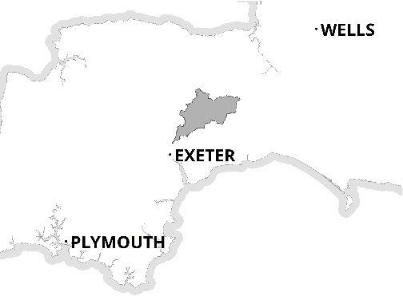
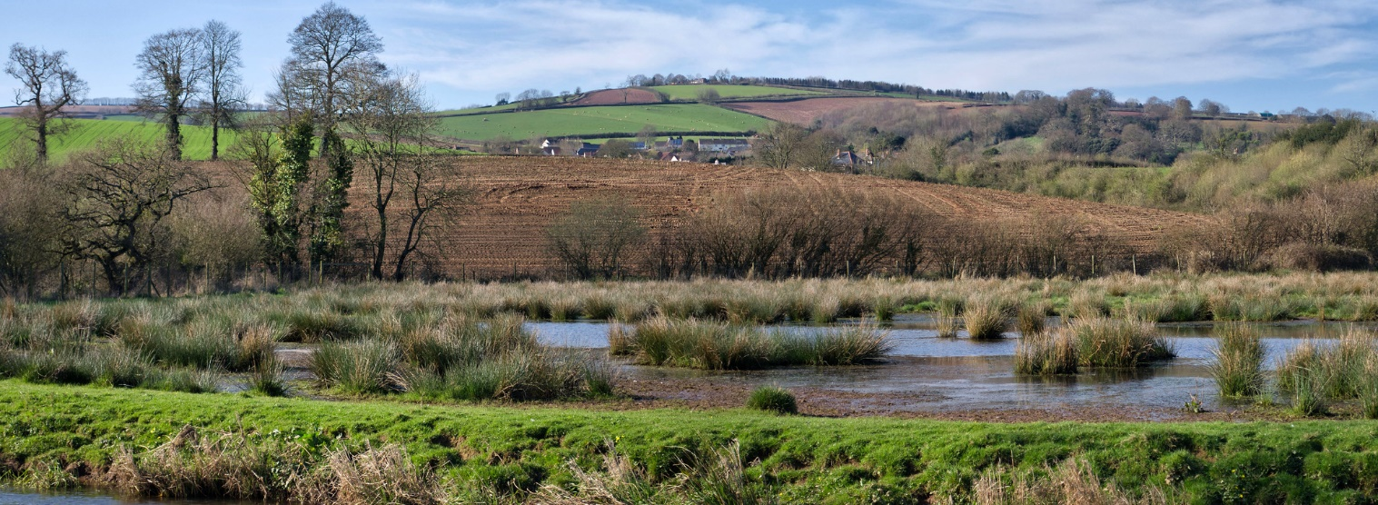
The River Culm catchment
The River Culm flows through the ‘Redlands’ of Mid and East Devon.
It is the longest tributary of the River Exe and drains an area of 280 square km.
The river rises at a spring near RAF Culmhead in the Blackdown Hills. From here it flows through Hemyock and Cullompton to join the River Exe to the north-west of Exeter.
The catchment is predominantly rural, comprising mixed woodland and agricultural (mostly pasture).
N
Add scale

Slide 17
River Culm catchment: natural vegetation
The majority of the Culm catchment is agricultural (87%) comprising improved grassland (62%) and arable (25%).
Woodland covers 9% of the catchment
Urban and suburban land uses comprise about 4% of the catchment
In predominantly a rural catchment, there is huge potential to capture and store carbon
Add scale

Slide 18
River Culm catchment: carbon stores and fluxes
Carbon is predominantly stored in trees, soils and sediments. Longer-term stores are the rocks underlying the catchment.
Carbon is in constant flux, with losses (through erosion and land use change) and gains (sequestration) through plants and soil.

Slide 19
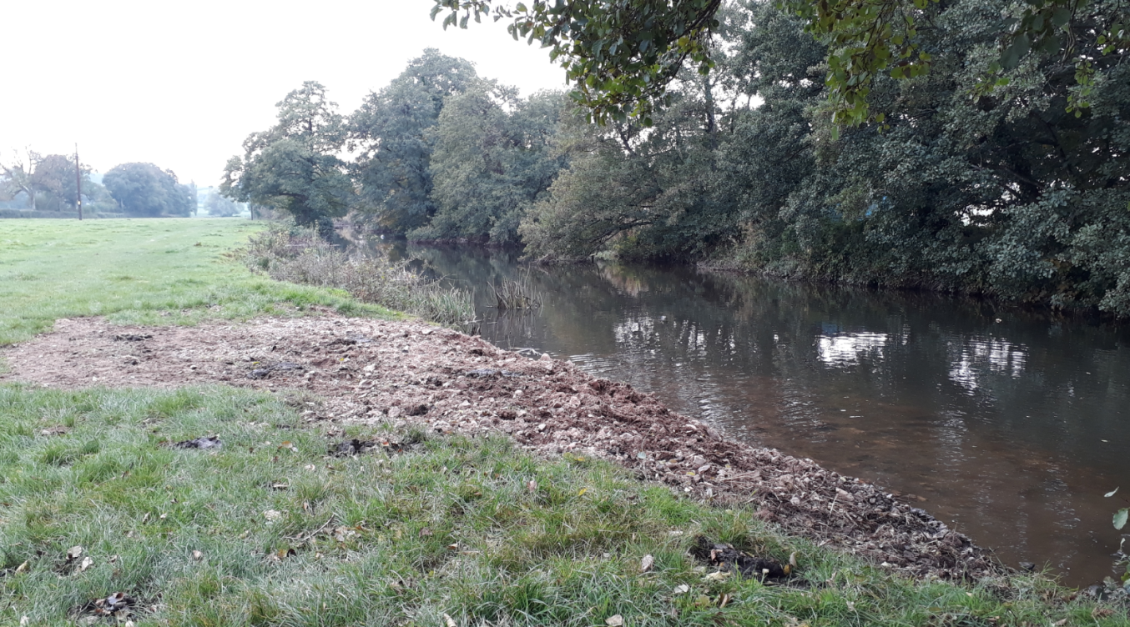
River Culm catchment: carbon releases
The River Culm transports dissolved organic and inorganic carbon (DOC and DIC) together with particulates to the River Exe and onwards to the English Channel.
Arable farming (tilling) or trampling (see photo) releases carbon stored in the soil.
Urbanisation (e.g. new housing developments in Cullompton) removes trees and disturbs soil, releasing carbon.

Slide 20
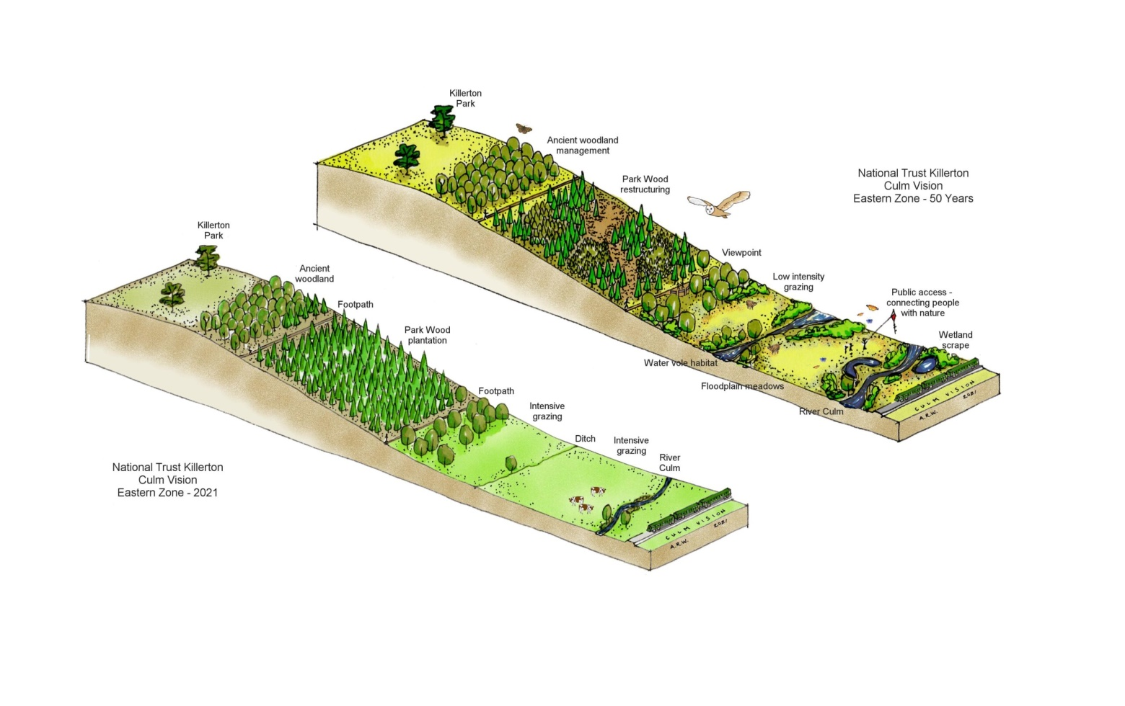
River Culm catchment: carbon capture (trees)
Planting trees – trees absorb (sequestrate) carbon dioxide from the atmosphere through the process of photosynthesis. Carbon is fixed in the trees and also transferred to the soil.
Some carbon is emitted through respiration and combustion.
The diagrams alongside illustrate a vision for enhancing nature and increasing carbon sequestration on the Killerton estate.
https://connectingtheculm.com/the-culm-a-50-year-vision-ellerhayes-to-columbjohn/

Slide 21
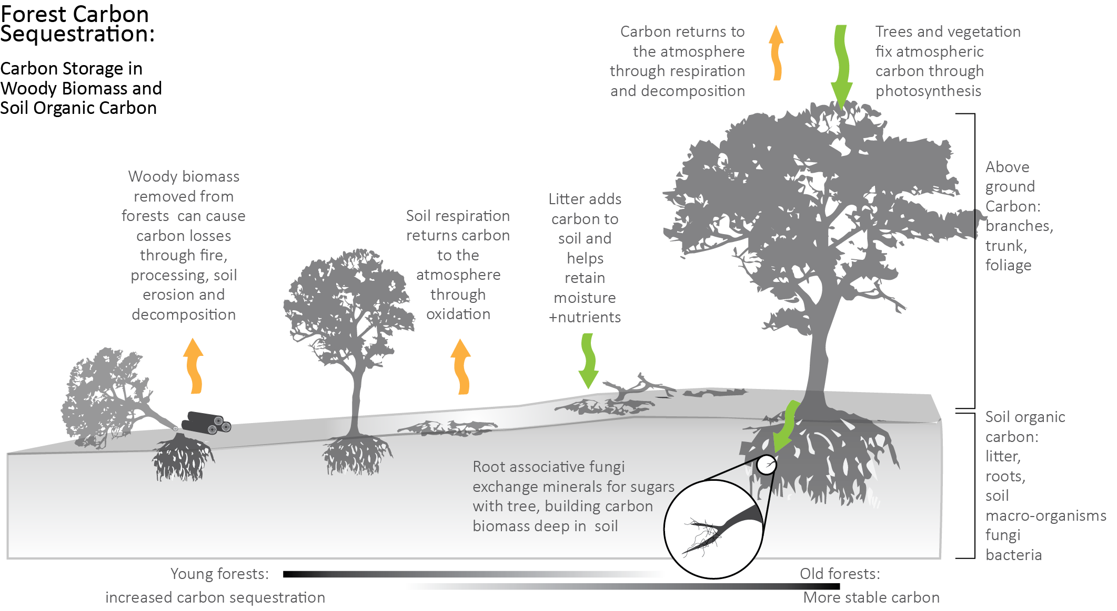
Carbon capture (trees)
http://bwsr.state.mn.us/carbon-sequestration-forests

Slide 22
Choosing tree types
Long-living native species such as oak and maple are effective in capturing carbon.
Other species suitable for smaller areas include hazel, blackthorn, elder, yew and crab apple.
Trees vary in their potential to capture and store carbon.
https://www.treeconomics.co.uk/wp-content/uploads/2021/01/Quercus-robur-varieties-Tree-Tag-v2.pdf

Slide 23
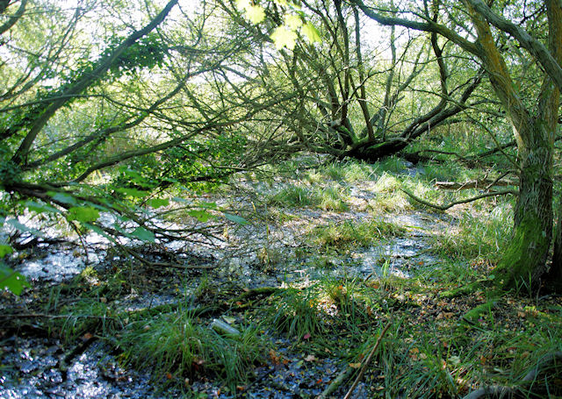
River Culm catchment: carbon capture (wetlands)
Globally, wetlands store 14.5% of the world’s carbon.
Retaining and reclaiming wetlands – wetlands are very effective carbon stores, capturing carbon within decaying peat vegetation.
Spring-line mires (see photo) form where rainwater draining into the soil meets underlying clay, forcing it to the surface.
Mires act like sponges, balancing rainfall events and releasing water gradually into rivers.
Many are not functioning effectively, having become scrubbed over with gorse and trees (see photo).
https://connectingtheculm.com/discover-the-culm/

Slide 24
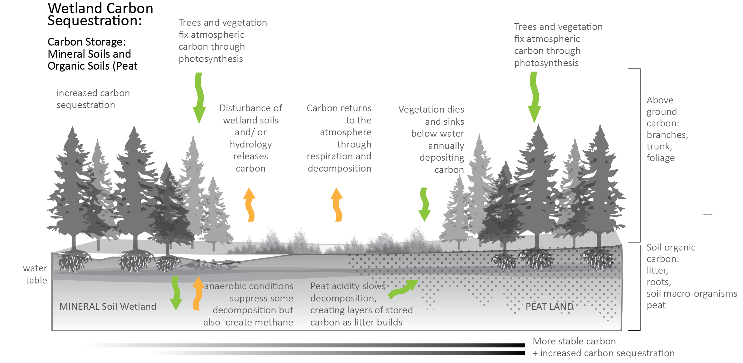
Carbon capture (wetlands)
http://bwsr.state.mn.us/carbon-sequestration-wetlands

Slide 25
Connecting the Culm – the model
Connecting the Culm is a three year project which aims to make the River Culm and its floodplain
more resilient to flood and drought
improve water quality
support biodiversity and habitats
involve local people and organisations in the process.
Climate change adaptation through nature based solutions is at the heart of the project
Mitigation strategies, reducing potential carbon emissions and increasing sequestration, can be adopted to reduce the catchment’s carbon footprint.
Co-creation
Connecting the Culm
Nature-based solutions
Climate change adaptation
https://connectingtheculm.com/discover-the-culm/

Slide 26
Connecting the Culm – climate regulation
Land uses identified by Natural England as contributing to climate regulation, included woodland, semi-natural habitats and urban green spaces.
The areas of woodland in the east of the catchment coincide with damp peaty/loam soils and wetlands to provide good locations for carbon sequestration.

Slide 27
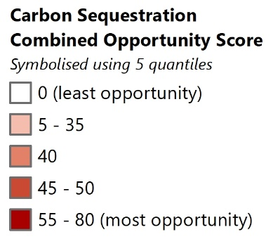
Connecting the Culm – carbon sequestration

Slide 28
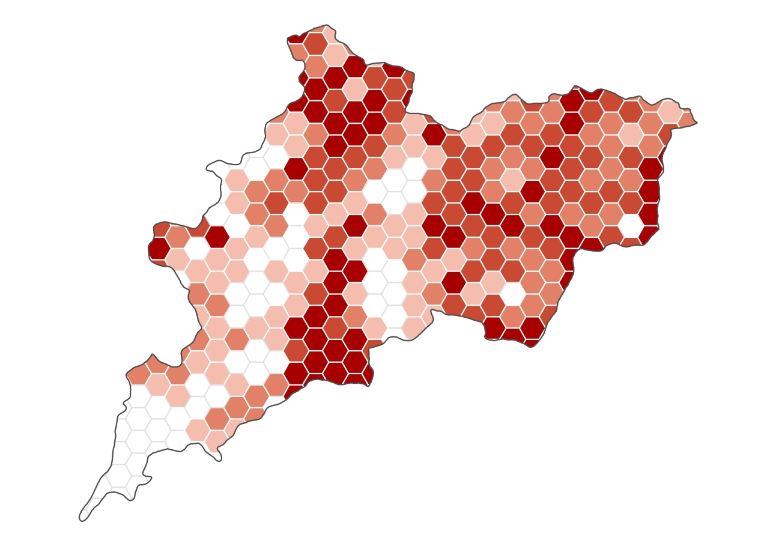
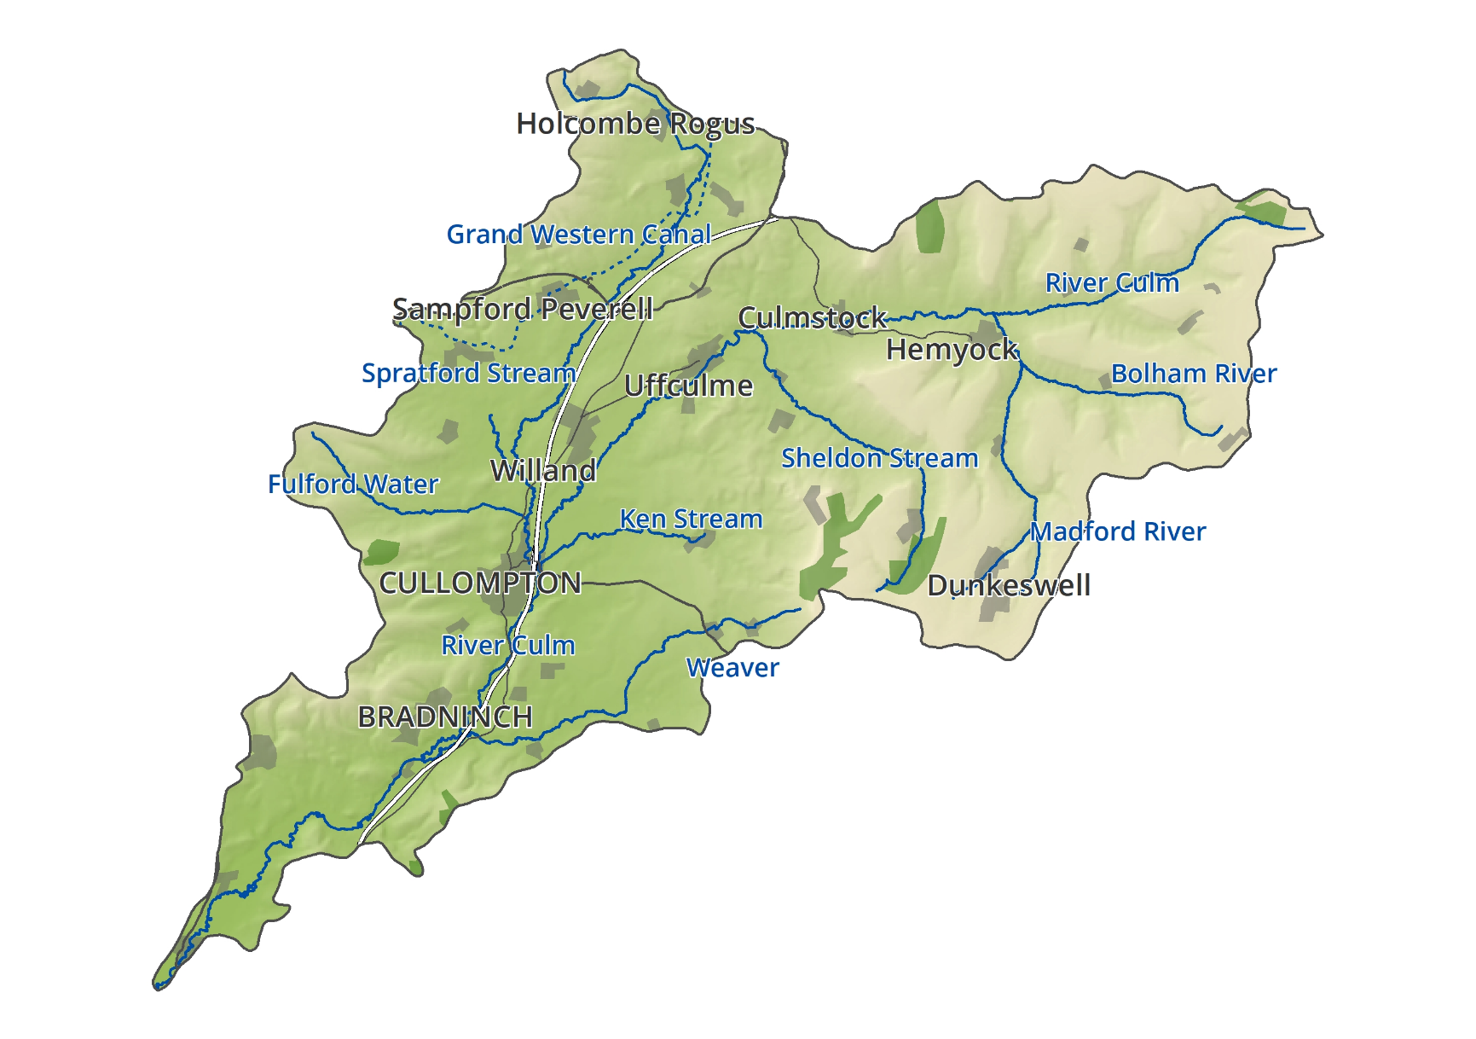
Connecting the Culm – opportunities for enhancement
Wetland opportunities combined with clay or loam soils
provide areas of greatest potential
Current land use, land type and soil type, combined with wetland opportunities suggest areas which have potential for improved carbon sequestration.
High quality agricultural land and other valuable land uses mean some
areas are unlikely to be suitable for land use change

